Slide 1
Monday 8th March 2021
LO: To sequence the events of an Antarctic exploration.

Slide 2
This week you will be writing a newspaper report, to inform the readers about the miraculous journey of Robert Falcon Scott and his crew.
What do you already know about the Antarctic?

Slide 3
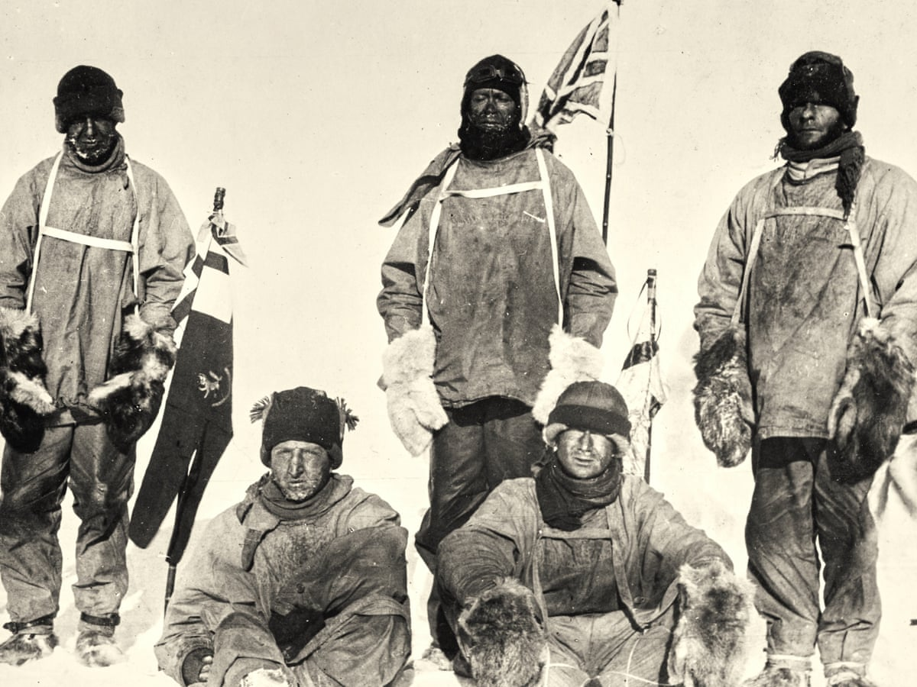
Robert Falcon Scott

Slide 4
Review the Features of a Newspaper report.
Headline
Introductory Paragraph – To capture the readers interest.
5 W’s (Who, what, where, when, why)
Pictures and Captions
Fact and opinion
3rd Person
Quotes
Concluding Paragraph
Time adverbials

Slide 5
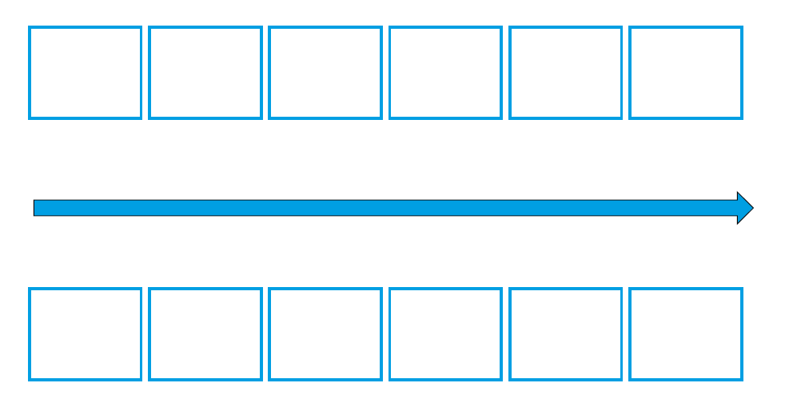
Create a timeline of events of Scott’s journey

Slide 6
Tuesday 9th March 2021
LO: To plan a newspaper report.

Slide 7
https://www.bbc.co.uk/bitesize/topics/z2yycdm/articles/z2gk9qt

Slide 8
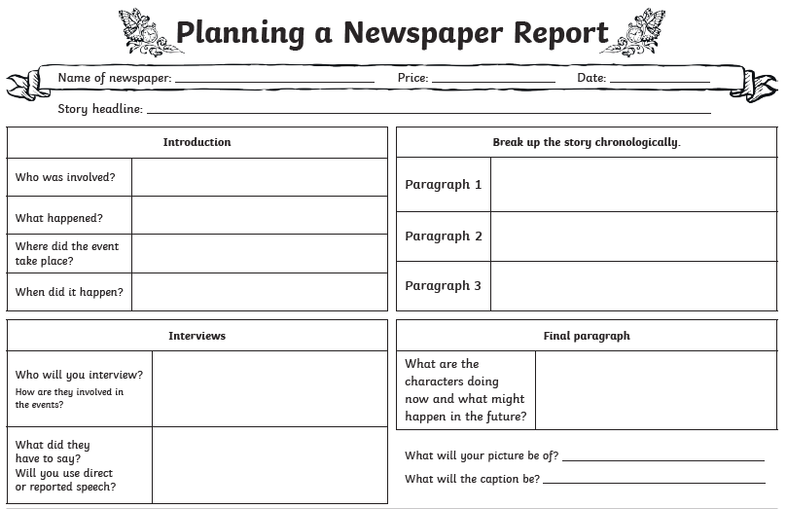

Slide 9
Wednesday 10th March 2021
LO. To draft and edit the introduction and P2 of a newspaper report

Slide 10
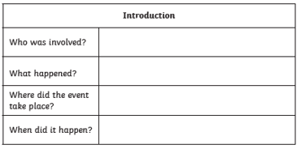
Focus today on the Headline and the Introduction paragraph
Why did it happen?

Slide 11
Things to consider when drafting your report.
Write on every other line – this will help with the next stage in the process.
Form each sentence in full before you write it down.
Consider the punctuation needed for each sentence as you write it.
Once you have written a sentence read it through to check it makes sense.

Slide 12
Introduction:

Slide 13
Paragraph 1:

Slide 14
Things to consider when editing your news article.
Read each sentence at a time
– ask yourself, does it make sense? Have I used
capital letters, full stops, question marks and
other punctuation accurately?
Choose 5 words that could be improved. Use a thesaurus to make stronger word choices.
Add 2 adjectives
Add 2 adverbs
Check you have used all of the features of letter writing.
When you have done this, swop your letter with your learning partner. Ask them to check against the list above to ensure you haven’t missed anything.

Slide 15
Friday 12th March 2021
LO. To draft and edit a newspaper report

Slide 16
Paragraph 2:

Slide 17
Paragraph 3:

Slide 18
Conclusion:

Slide 19
Things to consider when editing your news report.
Read each sentence at a time
– ask yourself, does it make sense? Have I used
capital letters, full stops, question marks and
other punctuation accurately?
Choose 5 words that could be improved. Use a thesaurus to make stronger word choices.
Add 2 adjectives
Add 2 adverbs
Check you have used all of the features of letter writing.
When you have done this, swop your letter with your learning partner. Ask them to check against the list above to ensure you haven’t missed anything.

