Slide 1


Slide 3
Work out the area of the shapes.
Each square represents 1 cm²
2) Find all the factors of 20
3) Find all the factors of 16

Slide 4
Work out the area of the shapes.
Each square represents 1 cm²
2) Find all the factors of 20
3) Find all the factors of 16
6 cm²
8 cm²
20 cm²
1, 2, 4, 5, 10, 20
1, 2, 4, 8, 16

Slide 6

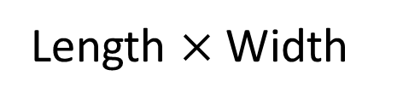
Use the diagram to complete the sentences.
Each square represents 1 cm²
4 cm
3 cm
Length $×$Width
Have a think
The length of the rectangle is 4 cm.
The width of the rectangle is 3 cm.
The total number of squares in the rectangle is 12
The area of the rectangle is 12 cm²

Slide 7
Which shapes have an area of 18 cm²?
Each square represents 1 cm²
6 cm
9 cm
3 cm
2 cm
16 cm²
Have a think

Slide 8
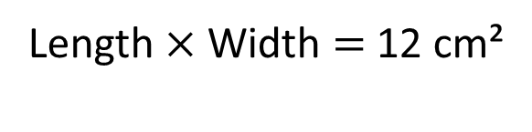
Draw a rectangle that has an area of 12 cm²
Each square represents 1 cm²
Length $×$Width $=$ 12 cm²
1 and 12
12
3 and 4
2 and 6
Have a think

Slide 9
Have a go at questions
1 – 4 on the worksheet

Slide 10

3 cm
5 cm
The area is 15 cm² because 5 multiplied by 3 is 15
Have a think

Slide 11
3 cm
5 cm
The area is 15 cm² because 5 multiplied by 3 is 15
9 cm²
Each square represents 1 cm²

Slide 12
Have a think
Can you draw a different rectilinear shape that has an area of 9 cm²?
Each square represents 1 cm²

Slide 13
Have a go at the rest of the questions on the worksheet

