Slide 1
Writing a balanced argument
Day 1

Slide 2
Success criteria
I can find the two sides of an argument.
I can find evidence to support the arguments.
I can use a range of connectives in my work.
I can write using an impersonal voice.
I can argue for and against a point of view.

Slide 3
What are the features of a balanced argument?
While television is a good source of education, it is a worry that children watch so much and the quality of what they watch is sometimes questionable? Leisure activities can be expensive but the old fashioned family pursuit of simply spending time together has been killed off, to a great extent, by a reliance on the box for all entertainment.
However, life today is very hectic, and being able to wind down in front of the television is a good form of relaxation. This does however mean that children are generally more unfit these days because they spend too much time in front of the television.

Slide 4
What are the features of a balanced argument?
Introduction- statement of the issue to be discussed?
Clearly presented arguments
Third person
Present tense
Impersonal voice
Range of connectives
Balanced argument
Conclusion

Slide 5
Example connectives
Also further more however but although on the other hand in spite of this because in comparison alternatively other than except

Slide 6
The introduction
  Organic food has become more popular over the past few years and because the demand for it has risen, a wider range of organic foods have become available in the shops. But what is organic food and is it better for us than non-organic produce? Or is it just a waste of money?

Slide 7
The introduction
The introduction must gain the readers attention.
It must explain the topic and use examples to highlight why there is a discussion.
It should be impersonal. I don’t like television, would not work!

Slide 8
The introduction

Slide 9

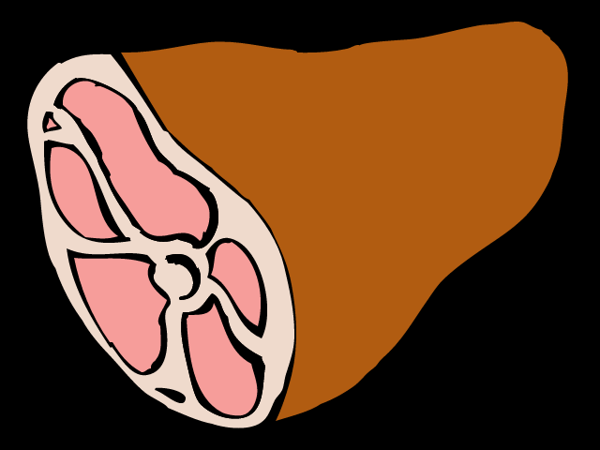
Is it okay to eat meat?

Slide 10
The conclusion
So is organic food better for us? Is it better for the environment? On the one hand, organic farmers claim their produce is healthier, while on the other, the Food Standards Agency says there is no scientific proof that organic food is any more safe or nutritious than non-organic!
Whoever is right, the reality is that most people still choose to buy non-organic food. Is this because they believe such food is safe and nutritious? Or is it because organic food is usually more expensive and they do not want to pay the extra? But in the end it’s up to you. Organic or non-organic? What do you think?

Slide 11
The conclusion
The conclusion must summarise either side.
Sometimes it will reach a decision.
Sometimes it will ask the reader to decide for themself.
You decide!

Slide 12
The conclusion

