Slide 1
Pompeii and Mount Vesuvius
https://www.theschoolrun.com/homework-help/pompeii
First let’s read the ‘about’ section.

Slide 2
Quick Start
When did people start living in Pompeii?
Where is Pompeii?
How many people lived there?
What is Mount Vesuvius?
When did Mount Vesuvius erupt?
Whose letters have taught us lots about Pompeii and Mount Vesuvius?

Slide 3
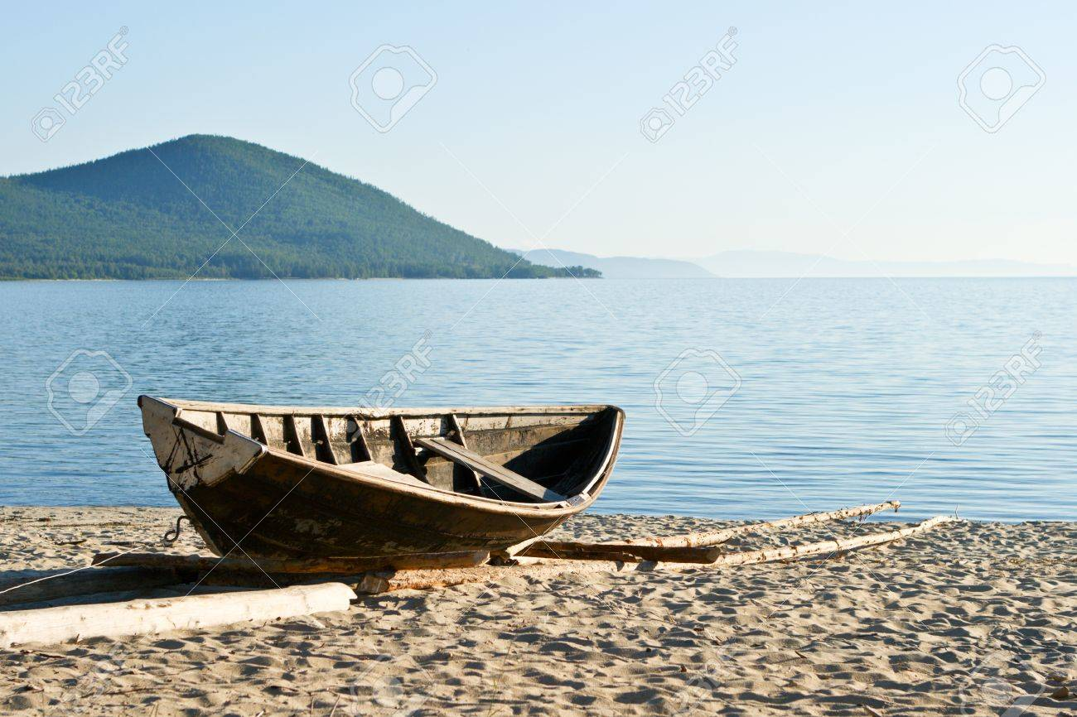
Vocabulary Check
Pompeii is found close to the coast where ships could come ashore.

Slide 4
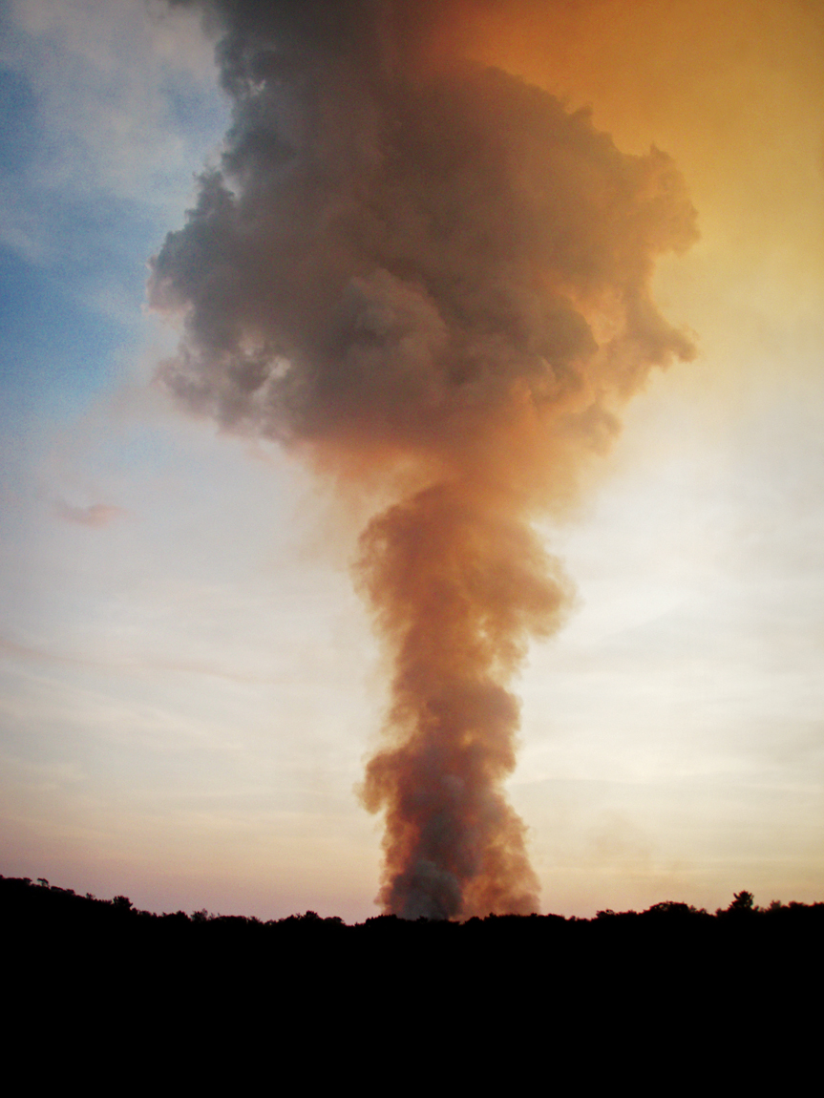
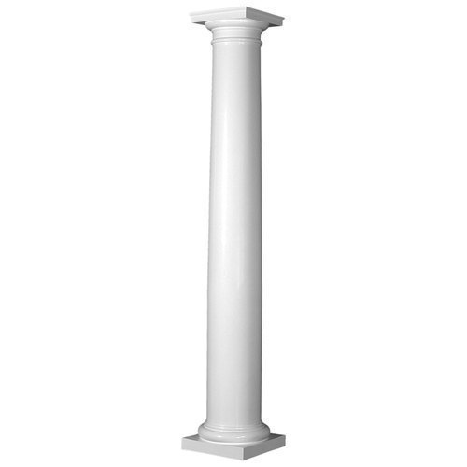
Vocabulary Check
a huge pillar-looking cloud that was over 20 miles up into the sky

Slide 5
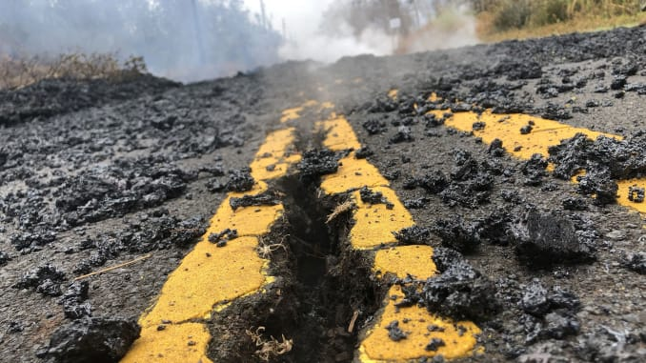
Vocabulary Check
Once the debris had stopped falling

Slide 6
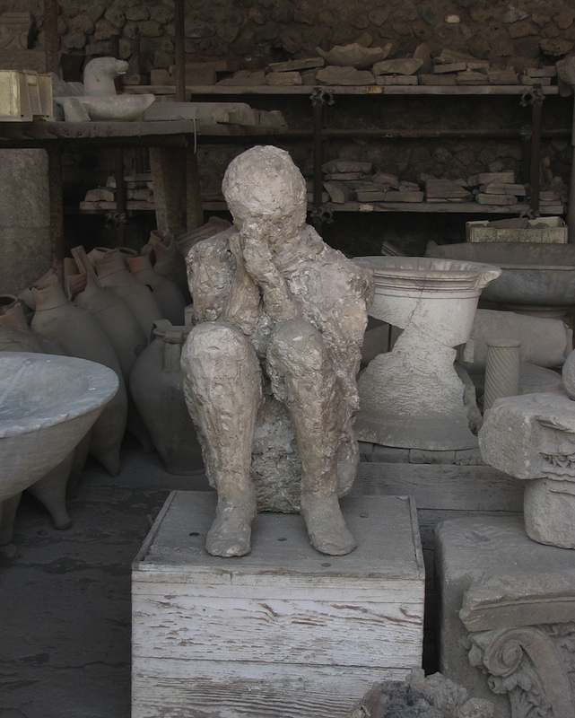
Vocabulary Check
Today the city of Pompeii is a tourist site, but is also protected and preserved

Slide 7
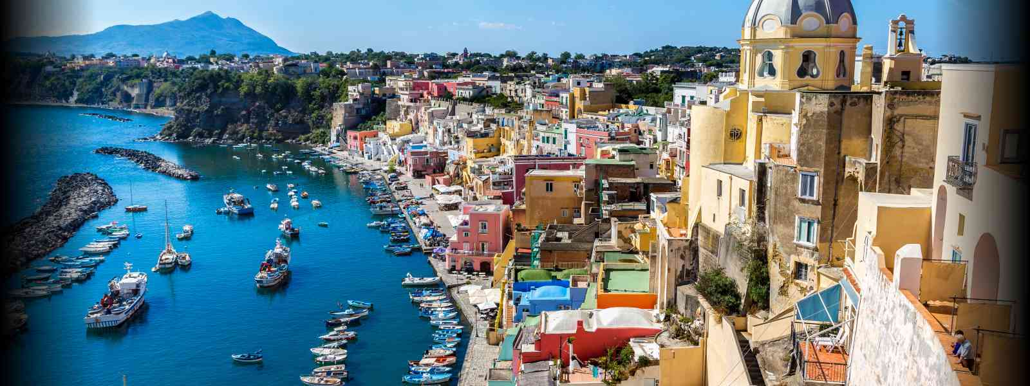
Vocabulary Check
The surrounding area is still inhabited and Naples is a thriving port city
were Vesuvius to erupt again all of the people would need to be evacuated very quickly.

Slide 8

Individual Thinking
Look at Paragraph 4 and consider if the following statement is true or false:
When Mount Vesuvius erupted, it would have made Pompeii very dark.

Slide 9

Partnered Talk
Today, Pompeii is preserved and protected as a heritage site. Why do you think it is important that places like Pompeii are preserved and protected?

Slide 10
Individual Thinking
In 79AD, do you think that the disaster of the eruption of Mount Vesuvius could have been avoided? Use the text to explain your answer.

Slide 11

Solo Work - Quiz Notes
You now have eight minutes to read ‘top 10 facts’ and ‘did you know’. Make notes on what you think is the most relevant information. There will be a short quiz afterwards where the text will be taken away and you will only have your notes.

Slide 12
Quiz Notes - The Quiz
How high was the mushroom cloud of smoke?
How hot was the pyroclastic flow?
How long did the eruption last?
When was Pompeii rediscovered?
When was the last time Mount Vesuvius erupted?
Name one of the other places destroyed by the eruption in 79AD.
Approximately how many people died in the destruction of Pompeii?
How did archeologists recreate the bodies of those who had died?
What is the type of eruption that came from Mount Vesuvius called?

