Slide 2
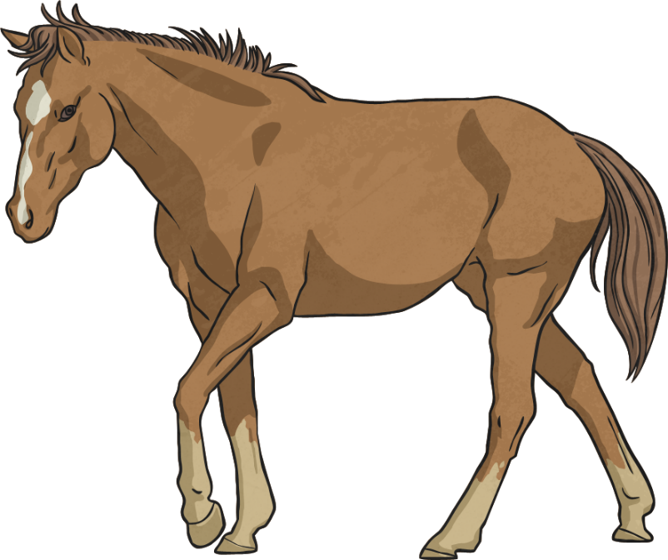
Grammar and Punctuation
Use a modal verb to change these sentences.
Tom writes poetry.
Tom can write poetry.
Beth acts in plays.
Beth should act in plays.
Lily speaks French.
Lily can speak French.
I ride horses.
I shall ride horses.
Max solves maths problems.
Max will solve maths problems.

Slide 3
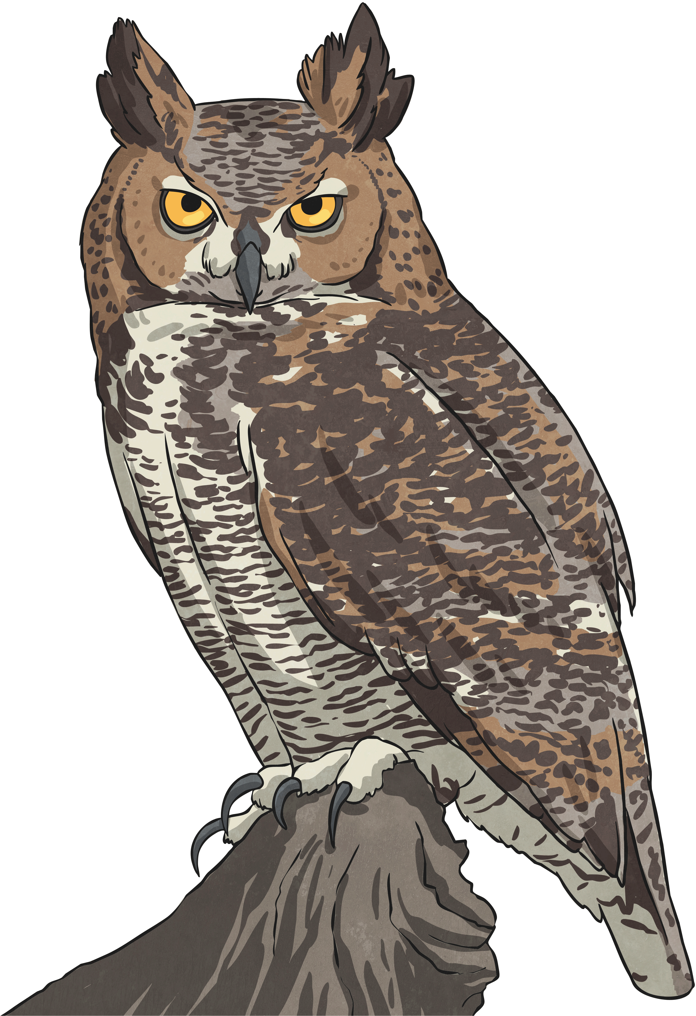
Grammar and Punctuation
Put the correct homophones in the gaps:
doing best!
your/you’re
You’re
your
wear
What are you going to ?
wear/where
weigh
How much do you now?
way/weigh
prey
The owl swooped on its .
pray/prey

Slide 4

Grammar and Punctuation
Change these sentences in the active voice, to the passive voice.
Leonardo da Vinci painted the Mona Lisa.
The Mona Lisa was painted by Leonardo da Vinci.
The pencil was held by the teacher.
The teacher held the pencil.
The ball was balanced on the seal’s nose.
The seal balanced the ball on its nose.
The boys pushed the tree over.
The tree was pushed over by the boys.

Slide 5
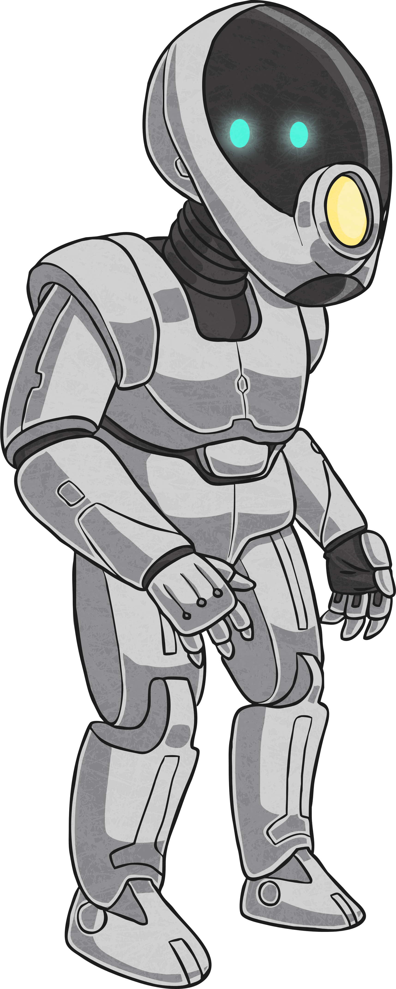
Grammar and Punctuation
Rewrite the sentences putting in the missing hyphens.
The robot has large, monster like cylinders where his eyes should be.
-
The Jones twins were football mad.
-
The gangster was a money grabbing man!
-
Meg was embarrassed and tongue tied.
-

Slide 6
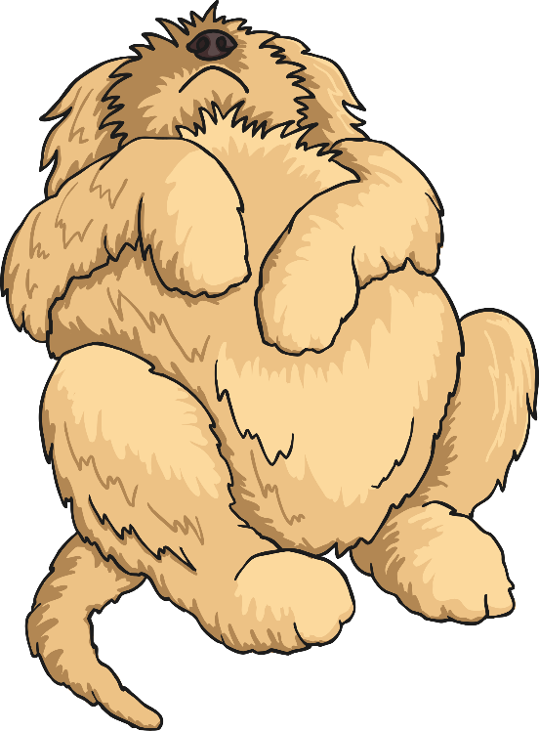
Grammar and Punctuation
Fill in the missing prepositions.
The horseman rode the cliff edge.
along
beside
The dog lay the warm fire.
during
The woman talked the film.
We hid the bridge.
under
among
The badger scurried the dead leaves.

