Slide 1
Starter
What is the adverbial telling us? Where, when , how, how often?
Glowing with pride, the winner received his medal.
Before long, the children were lost.
At school, Emma was told off for talking in assembly.

Slide 2
L.I. To know how authors portray characters
Success Criteria
I can identify words for character’s appearance.
I can make inferences about a character’s feelings.
I can make inferences about a character’s behaviour.

Slide 3
Characterisation is a term used to describe the way a character is developed by the author.
We get to know what a character is like by the way the author gives details about the character’s appearance, behaviour, thoughts and feelings.

Slide 4
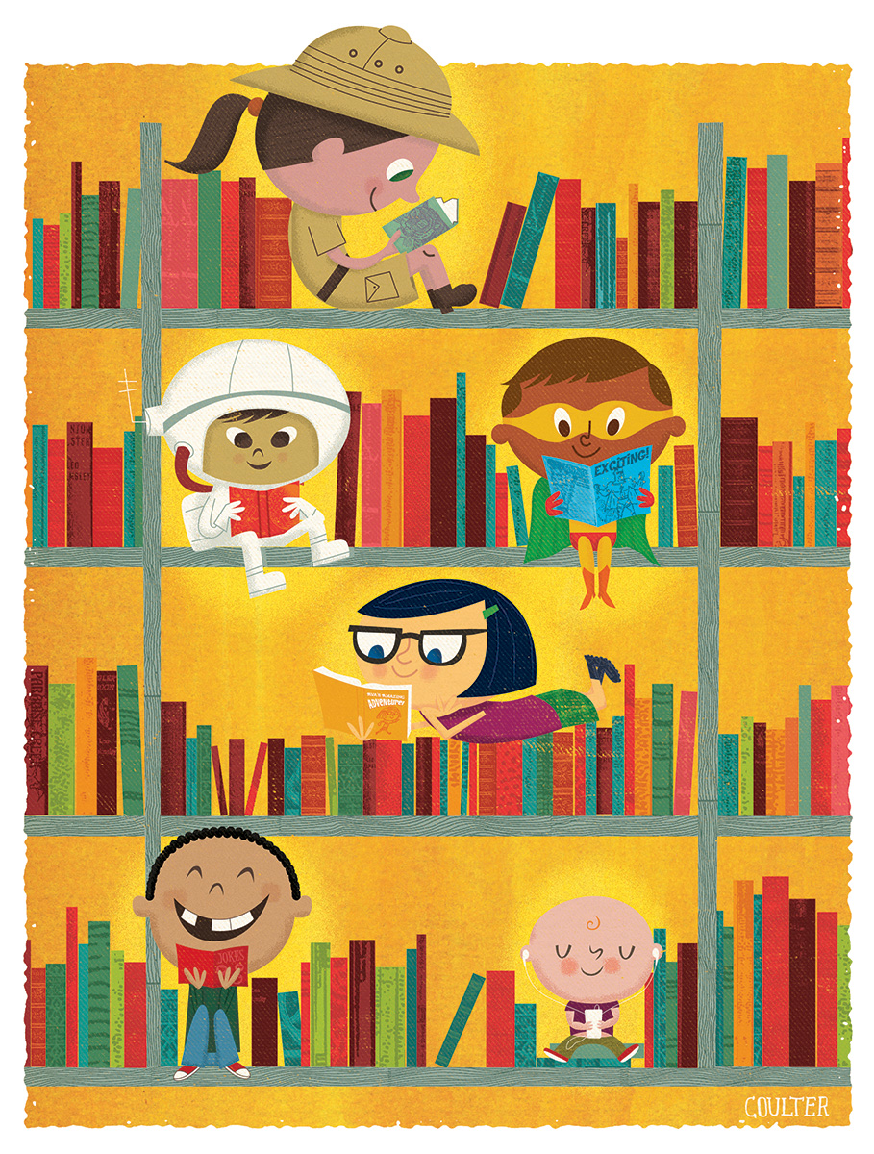
Characters……
Let’s read the following extracts and work out how the author portrays the characters.
Making them real

Slide 5
Harry Potter- J K Rowling
Harry had always been small and skinny for his age… Harry had a thin face, knobbly knees, black hair and bright green eyes. He wore round glasses held together with a lot of cellotape because of all the times Dudley had punched him in the nose. The only thing Harry liked about his appearance was a very thin scar on his forehead which was shaped like a bolt of lightning.
Can you tell me what information we learn about Harry from this description?
Is there much left for us to work out?

Slide 6
Jo- Bleak House
Charles Dickens
Jo sweeps his crossing all day long, and if he is asked a question he replies that he "don't know nothink." He knows that it's hard to keep the mud off the crossing in dirty weather, and harder still to live by doing it. Nobody taught him that much—he found it out.
Indeed, everything poor Jo knows he has had to find out for himself, for no one has even taken the trouble to tell him his real name.
Notes:
The focus on his lack of knowledge shows Jo to be poor in every sense.

Slide 7
It must be a strange state to be like Jo, not to know the feeling of a whole suit of clothes—to wear even in summer the same queer remnant of a fur cap; to be always dirty and ragged; to shuffle through the streets, unfamiliar with the shapes, and in utter darkness as to the meaning, of those mysterious symbols so abundant over the doors and at corners of the streets, and on the doors and in the windows. To see people read, and to see people write, and to see the postman deliver letters, and not to have the least idea of all that language,—to be to all of it stone blind and dumb.
What do you know about Jo?
Notes:
Repetition of ‘to see’ emphasises the contrast of being blind to language.

Slide 8
Mrs.Pratchett- Boy Roald Dahl
Activity - highlight the simile
Her name was Mrs. Pratchett. She was a small skinny old hag with a moustache on her upper lip and a mouth as sour as a green gooseberry. She never smiled. She never welcomed us when we went in. By far the most loathsome thing about Mrs. Pratchett was the filth that clung about her. Her apron was grey and greasy. Her blouse had bits of breakfast all over it, toast crumbs and tea stains and splotches of dried egg yolk. It was her hands , however, that disturbed us most. They were disgusting. They were black with dirt and grime. They looked as though they had been putting lumps of coal on the fire all day long. The mere sight of her grimy right hand with its black fingernails digging an ounce of Chocolate Fudge out of the jar would have caused a starving tramp to go running from the shop.
Describe Mrs. Pratchett in 3 words.
What does she do for a living?
How do you think she would speak or move?
Give an example.
Notes:
For the EXT chn

Slide 9
Calpurnia-To Kill a Mockingbird Harper Lee
She was all angles and bones; she was nearsighted; she squinted; her hand was wide as a bed slat and twice as hard. She was always ordering me out of the kitchen, asking me why I couldn't behave as well as Jem when she knew he was older, and calling me home when I wasn't ready to come. Our battles were epic and one-sided. Calpurnia always won, mainly because Atticus always took her side. She had been with us ever since Jem was born, and I had felt her tyrannical presence as long as I could remember.
How has the author portrayed the character? Give an example of her behaviour which would cause the writer to ‘feel her tyrannical presence’? Highlight the simile.
Notes:
GD

Slide 10
From The Black Cauldron by Lloyd Alexander (Henry Holt, 1965)
A bellow of laughter resounded beyond the chamber, and in another moment a giant, redheaded warrior rolled in at the side of Adaon. He towered above all in the chamber and his beard flamed around a face so scarred with old wounds it was impossible to tell where one began and another ended. His nose had been battered to his cheekbones; his heavy forehead was nearly lost in a fierce tangle of eyebrows; and his neck seemed as thick as Taran’s waist.
What words tell us that the warrior is loud? Why has the author used the word ‘flamed’? Draw the warriors face and label using the words from the text.
Notes:
WT

Slide 11
Authors give details to show how a character is feeling.
Mary fought back tears, her bottom lip hung down and she shrugged her shoulders . It seemed to her as if the whole world was against her. She had done her best but failed the driving test.
We know how Mary is feeling without the author telling us that she is upset. This is showing us, not telling us.
Read the example text and underline the powerful lines where the author has shown but not told us what the character is like.

