Slide 1

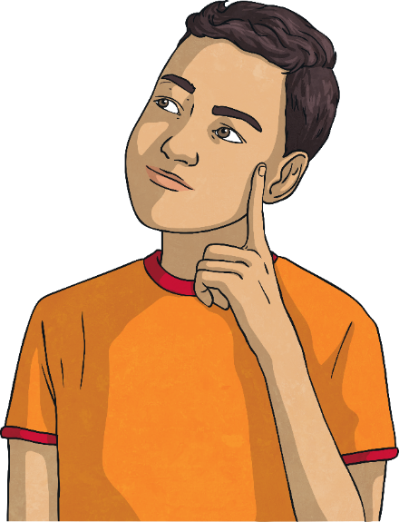
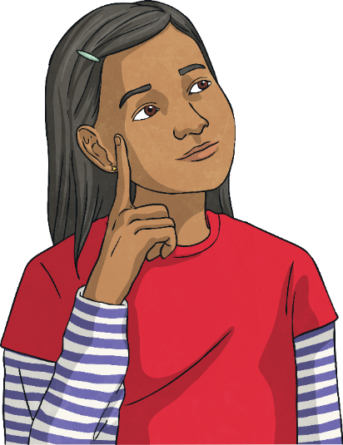
The Big Questions
How can we safely use mobile phones and other devices and stay safe when using the Internet?
What kind of thing must we never share
and why?
Share your thoughts with a partner and then with the class.

Slide 2

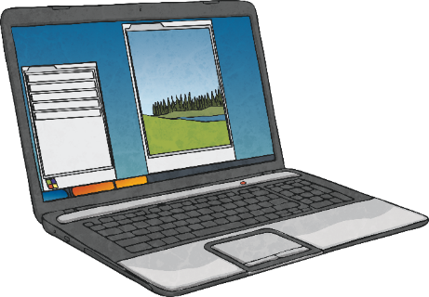
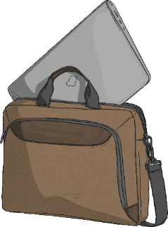

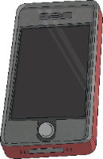

Mobile Devices
Mobile phones and other devices are expensive, so we need to take care
of them.
How can we take care of our mobile devices?
Keep them somewhere safe, keep them in a protective case and be careful not to spill anything on them.
Never take someone else’s phone or device without their permission and only lend your devices to those you trust, with your parents’ or carers’ permission.

Slide 3
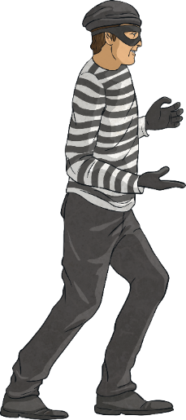
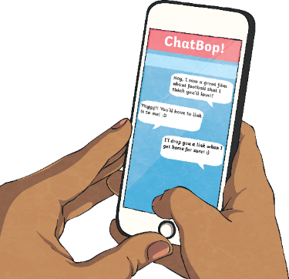
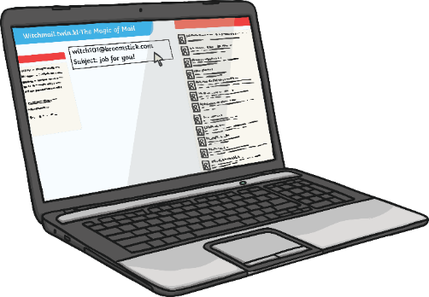
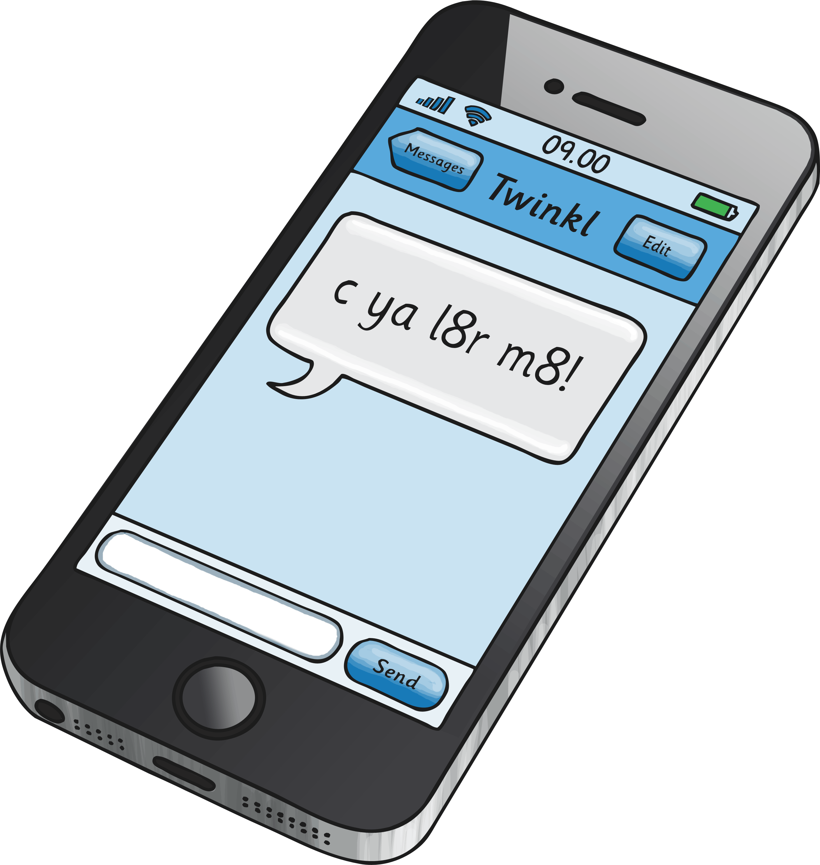
Mobile Devices
How can we make sure others don’t have access to our devices?
Just as we keep our passwords safe for emails and accounts we use on our computers, we need to keep our passcodes for mobile devices private so our friends cannot use them without our permission.
What should you do if your mobile device gets lost or stolen?
If you lose your mobile device or have it stolen, you need
to tell a trusted adult straight away.

Slide 4

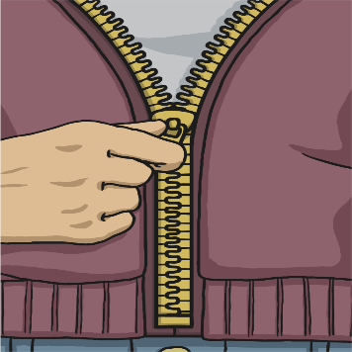
Zip It, Block It, Flag It
Zip It!
‘Zip it’ means not talking! OK, so of
course you are going to talk on a chat
site but you really need to think carefully about what you say and the information you share.
Never give away your real name, your address, the name of the school you go to or details about clubs you attend.

Slide 5
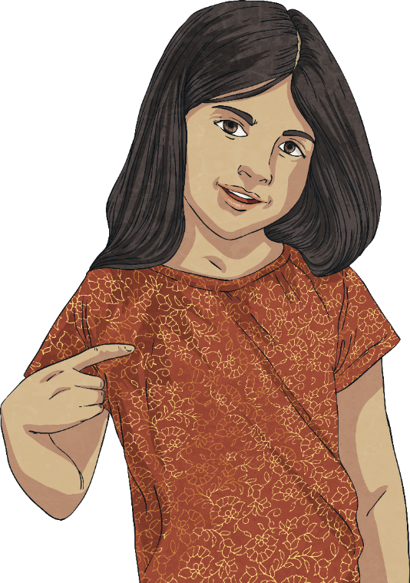

Zip It, Block It, Flag It
When you see something online that doesn’t seem right, you need to act responsibly.
Block It!
Block and delete emails from anyone you don’t know.
Never open attachments from unknown sources – they could contain a nasty virus!
If someone says, posts or sends anything unkind or inappropriate to you, block them and tell a trusted adult. This applies to emails, text messages and all forms of online communication, including social media and online gaming.

Slide 6

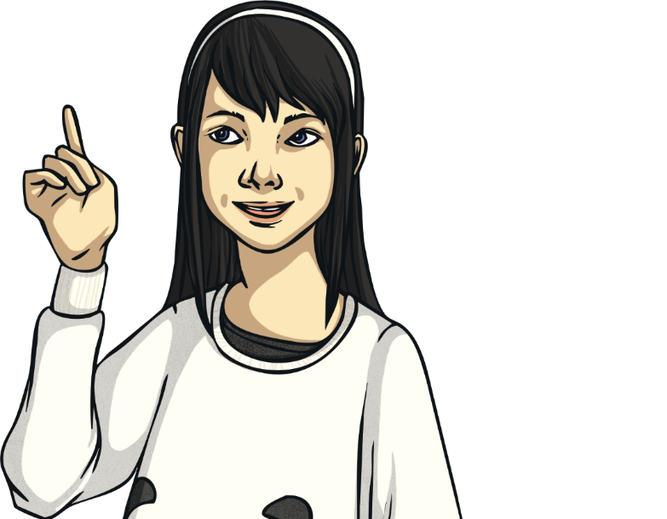
Zip It, Block It, Flag It
It is important to flag up anything that isn’t right.
Tell a trusted adult about what you have seen or
what has happened and they can help. This could
be a parent or carer, or someone at school.
Flag it!
You need to flag:
cyberbullying;
someone you don't know, or that you have met online, asking to meet you in person;
anything that upsets, scares or worries you;
anything you think might be illegal.

Slide 7

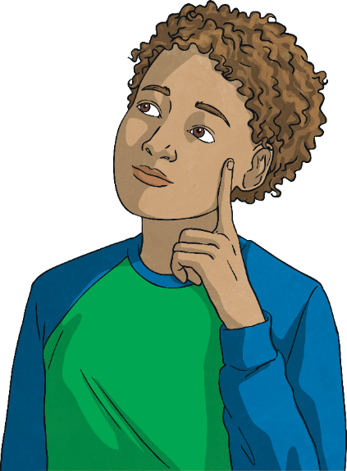
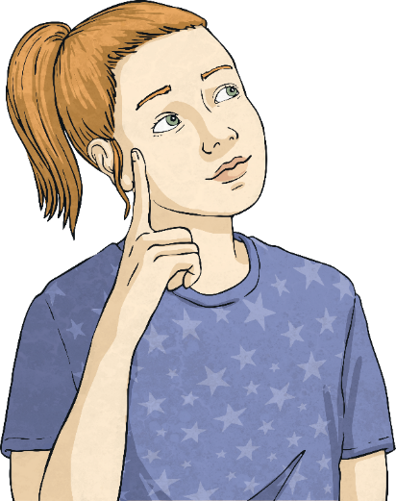
The Right to Privacy
What does privacy mean?
Discuss what you think this means with
your partner.
Everyone has a
right to privacy.
Privacy means keeping things private or confidential.
Privacy means not sharing something, such as certain information, with others.

Slide 8
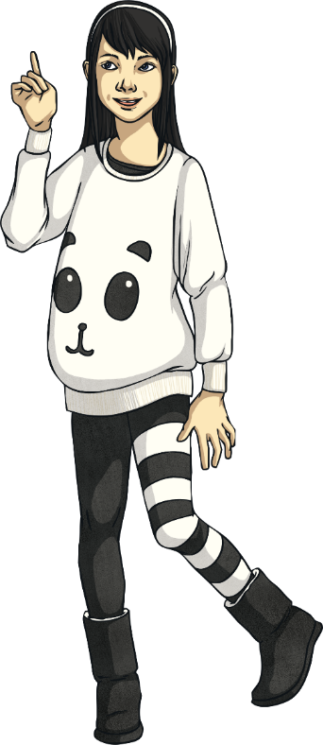
The Right to Privacy
How did you do? Were some questions trickier than others to
answer? Did you and your partner agree on all the answers?
Let’s take a look at the answers together.
Is it OK to post your address online to a friend you know from school?
This is a bad idea as the Internet is not private.
You might post your address to your friend on a social network but their privacy settings might mean that others can see it.
If you need to give your address to your friend, it would be better to ask your parents or carers to share the information, send it in a text message, or write it down on a piece of paper and give it to them.

Slide 9
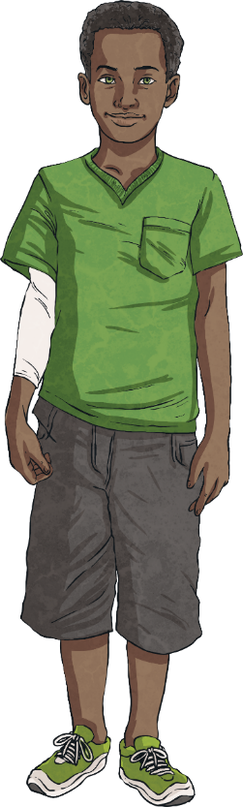
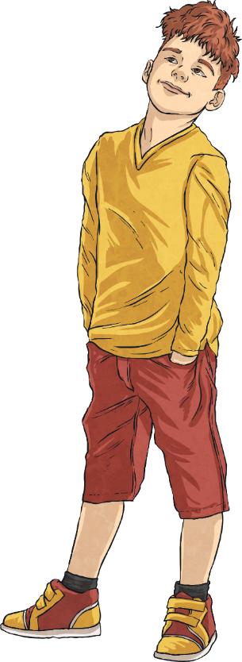
The Right to Privacy
How did you do? Were some questions trickier than others to
answer? Did you and your partner agree on all the answers?
Let’s take a look at the answers together.
Is it OK to put a photo of your friend online, that you took on your phone?
It is not OK to post a photo of someone online without their permission.
If you take a photo of someone and they want you to delete
it, you must respect their wish and respect their privacy.
You wouldn’t want someone to post a photo of you online without your consent, so don’t do it to someone else.

Slide 10
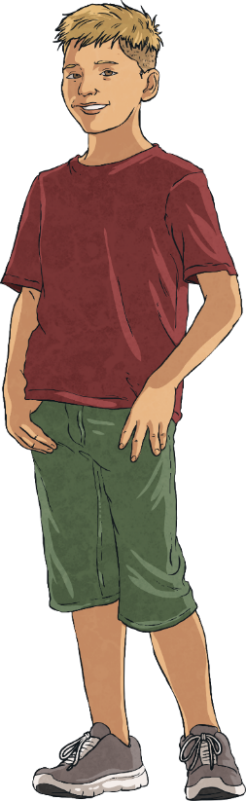
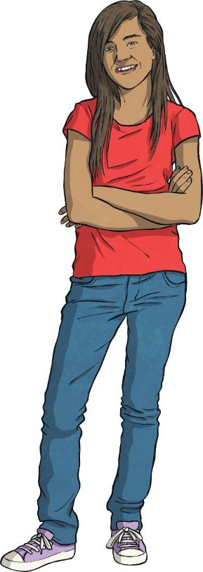
The Right to Privacy
How did you do? Were some questions trickier than others to
answer? Did you and your partner agree on all the answers?
Let’s take a look at the answers together.
Is it OK for your parent or carer to put a photo of you in your school uniform online, with your name underneath it?
One person can share it, or a friend of a friend can see it online.
This isn’t a good idea and it’s OK to tell your parent or carer that you do not want a picture of you shared on social media that shows your face, where you go to school and what your name is.
A photo like this would share too much personal information that you wouldn’t want a stranger knowing.
Once a photo has been shared online, it can never be
properly deleted.

Slide 11

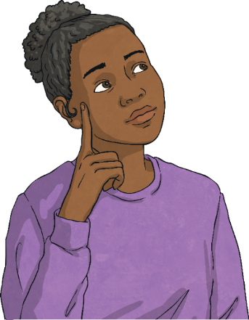
The Big Questions
How can we safely use mobile phones and other devices and stay safe when using the Internet?
What kind of thing must we never share and why?
What have you learnt today that will help you in everyday life?

