Slide 1
Develop questions about the Maya civilization

Slide 2
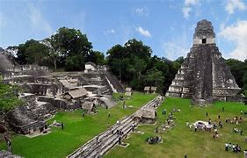
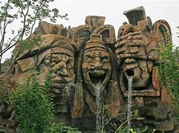
Maya Civilization pictures
Discuss what you know / want to know about the next 4 pictures.

Slide 3
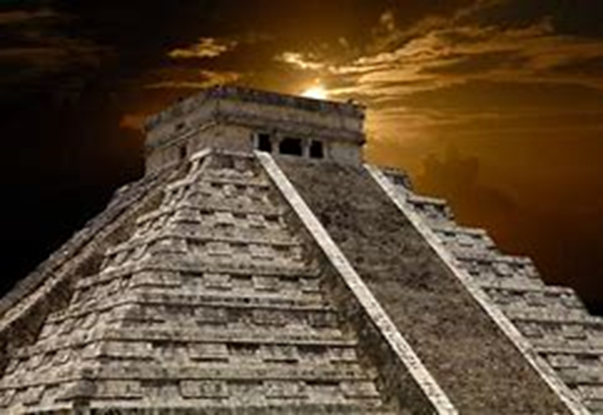
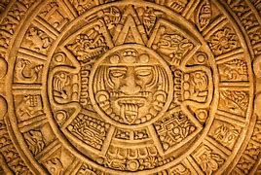
Write down on a whiteboard any questions you have thought of.

Slide 4
Task:
With your partner, you are going to write down questions you would like to find out about the Maya civilization.
These can include:
Dates, Geography, Buildings, People, Deities worshipped (Gods), Food & drink, Work, Sacrifice, Language, Religion, Medicine, Maya Collapse.
Create a PowerPoint presentation that ASKS QUESTIONS about the Mayans. Include pictures you can find on the Internet.
(Do not answer them today, we will do that in a future lesson)

Slide 5
Saving your work…

