Slide 2
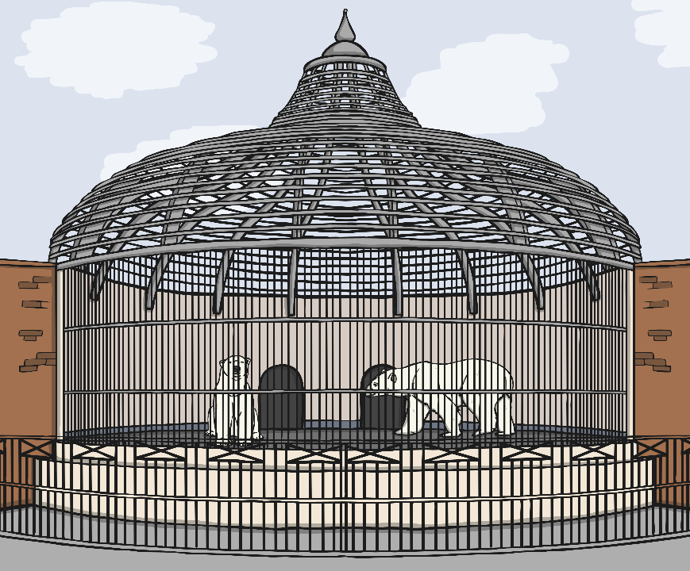
Grammar and Punctuation
Think of an adverb that would make sense in
each of these sentences:
I am forgetful.
often
outside
I left my suitcase .
Yesterday
I went to the zoo.
Write the sentences in your book

Slide 3
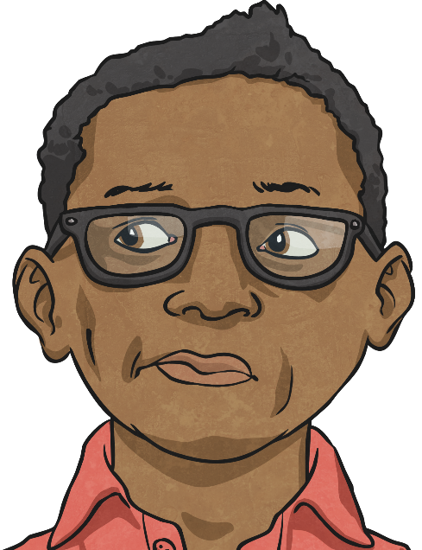
Grammar and Punctuation
Which prefixes would you add to these verbs?
dis
mis
re
agree
behave
turn
mis
dis
trust
allow
Write out some sentences using these words.

Slide 4
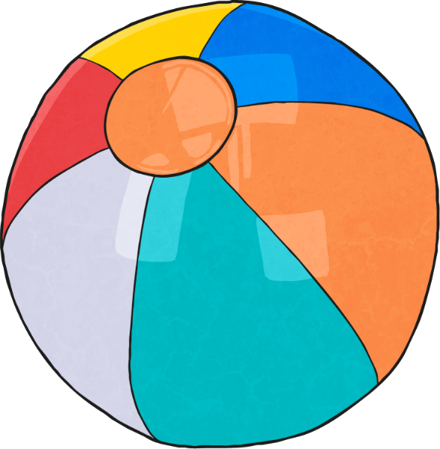
Grammar and Punctuation
How would you correct these sentences?
^{We was going swimming.}
^{We were going swimming.}
If we was not at school, I’d stay in bed.
If we were not at school, I’d stay in bed.
Martha were at her friend’s house.
Martha was at her friend’s house.
^{I were on holiday in Spain.}
^{I was on holiday in Spain.}

Slide 5
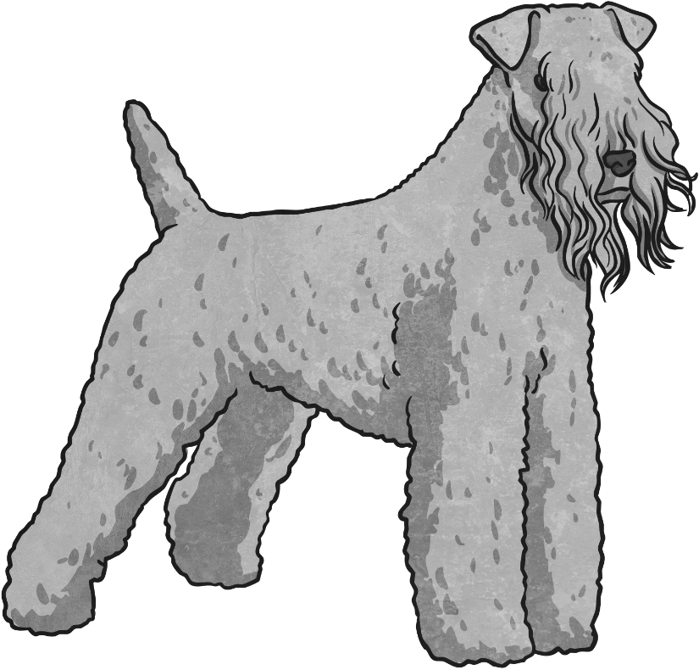
Grammar and Punctuation
Put brackets into these sentences.
My favourite book The Hobbit is a fantasy story.
My favourite book (The Hobbit) is a fantasy story.
It was a rainy day a Monday when the fire alarm went off!
It was a rainy day (a Monday) when the fire alarm went off!
The dog (which was called Sid) never stopped barking!
The dog which was called Sid never stopped barking!
Write your own sentences using brackets.

Slide 6
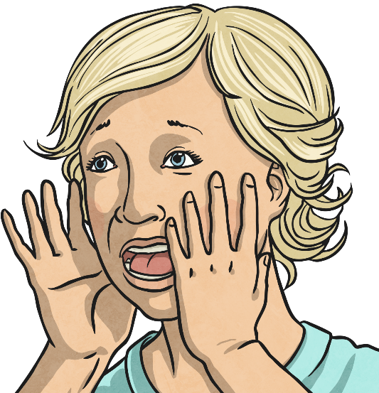
Grammar and Punctuation
Which interjection would you use?
Ouch
“ !” I shouted, when I fell over.
Hooray
All the children cheered “ !”
Hey
“ , give it back!”
Whoops
“ , that was close”, I said as I carried with the glass vase.
How many interjections can you think of?

Slide 7
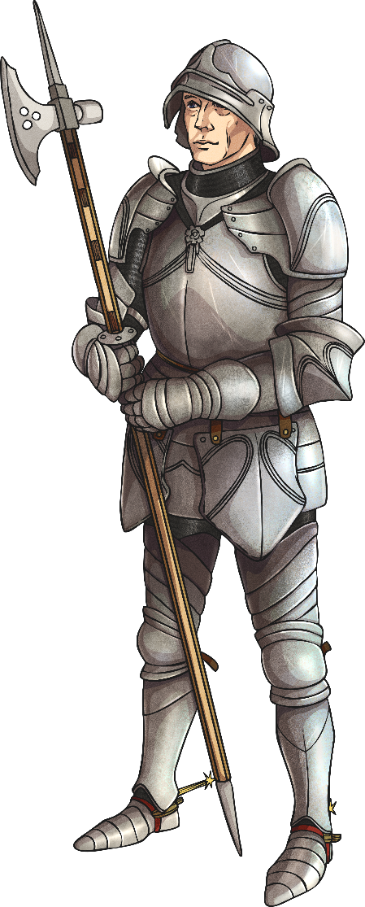
Grammar and Punctuation
List as many words as you can that have a silent letter.
For example: knight.
Use these words in your own sentences.
solemn
lamb
sword
gnome
bomb
knife
knife
thumb
whale
knock
write

Slide 8
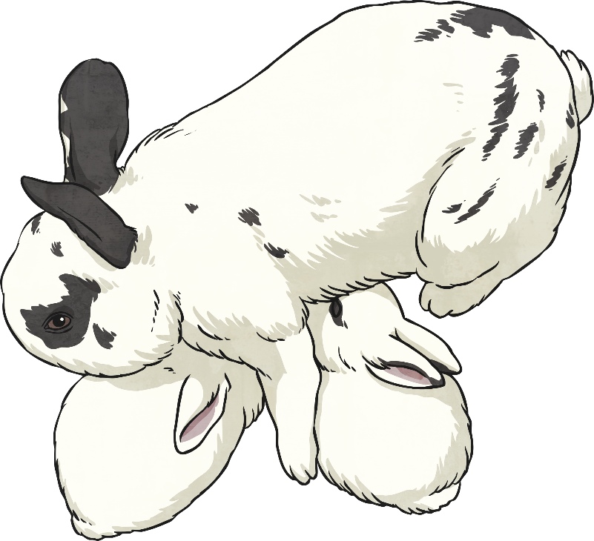
Grammar and Punctuation
Where should the apostrophe be in these sentences? Write the sentences correctly in your books.
Hannah’s mum worked at the hospital.
Hannahs mum worked at the hospital.
Barry, my sisters rabbit, was grey and white.
Barry, my sister’s rabbit, was grey and white.
Im going to the skatepark to see my friends.
I’m going to the skatepark to see my friends.
Mum hasnt got time to go to the hairdressers.
Mum hasn’t got time to go to the hairdressers.

Slide 9
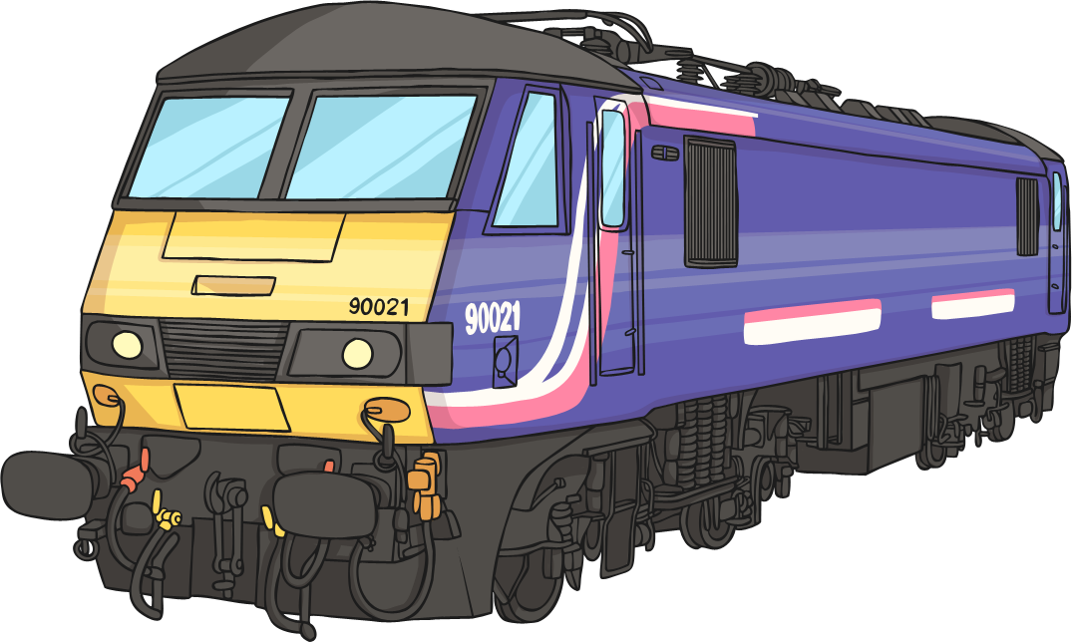
Grammar and Punctuation
Which fronted adverbial would make sense?
… the train pulled out of the station into the mist.
List as many as you can.
Slowly but noisily,…
With a shout from the station master,…

Slide 10
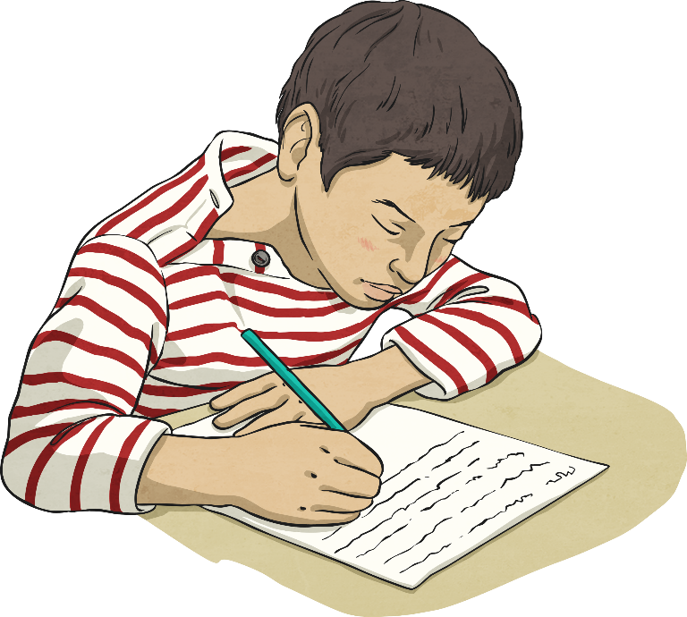
Grammar and Punctuation
Put in the missing semicolon:
Sam had worked hard he deserved to pass his exams.
Sam had worked hard; he deserved to pass his exams.
Kate opened the drawer it was empty.
Kate opened the drawer; it was empty.
The rabbit was looking rather ill it needed taking to the vets.
The rabbit was looking rather ill; it needed taking to the vets.

