Slide 1

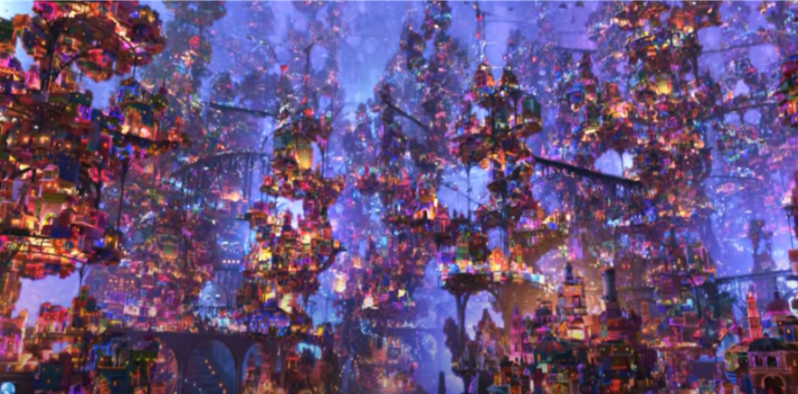
Click here
If the link doesn’t work then try pressing control + clicking

Slide 2
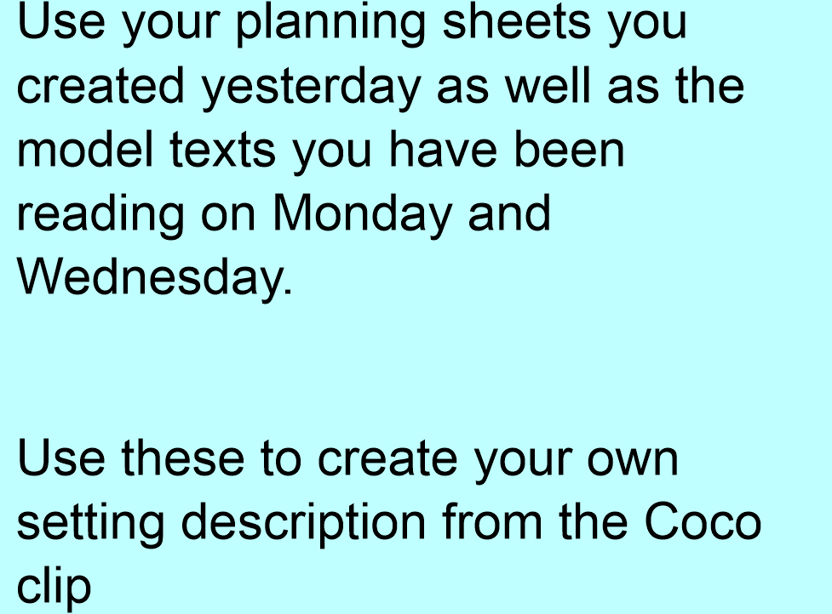

Slide 3


