Slide 1
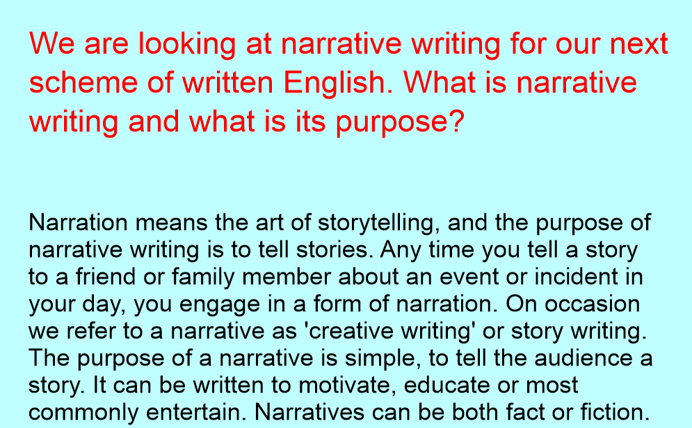

Slide 2
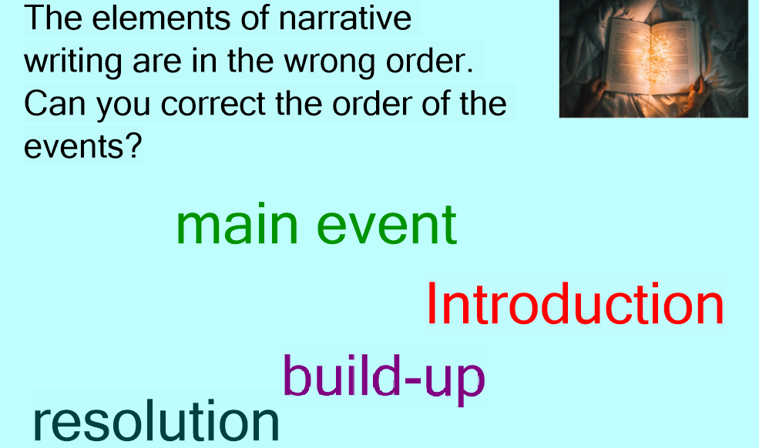

Slide 3
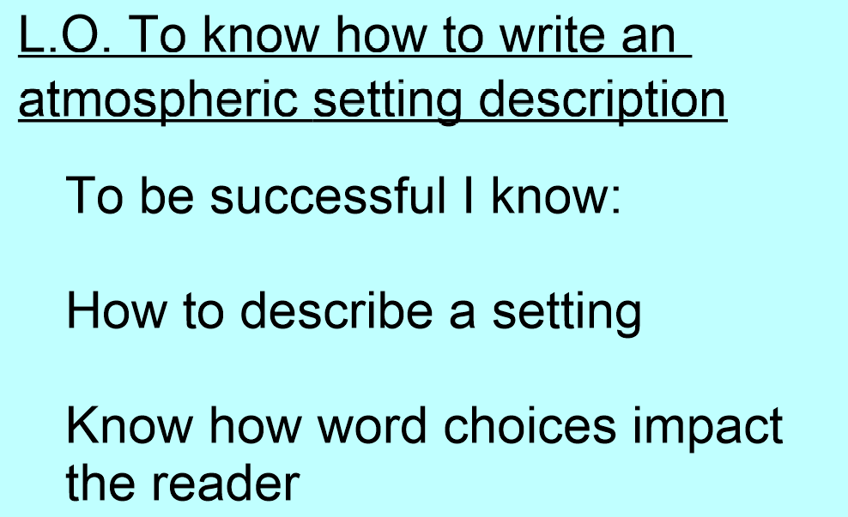

Slide 4
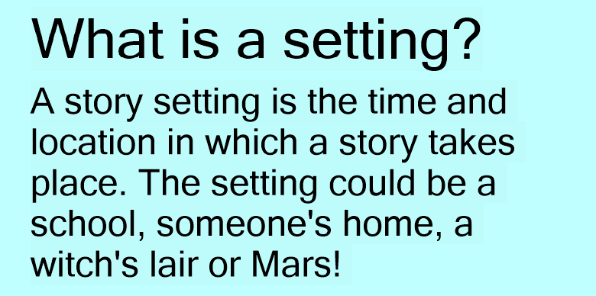

Slide 5
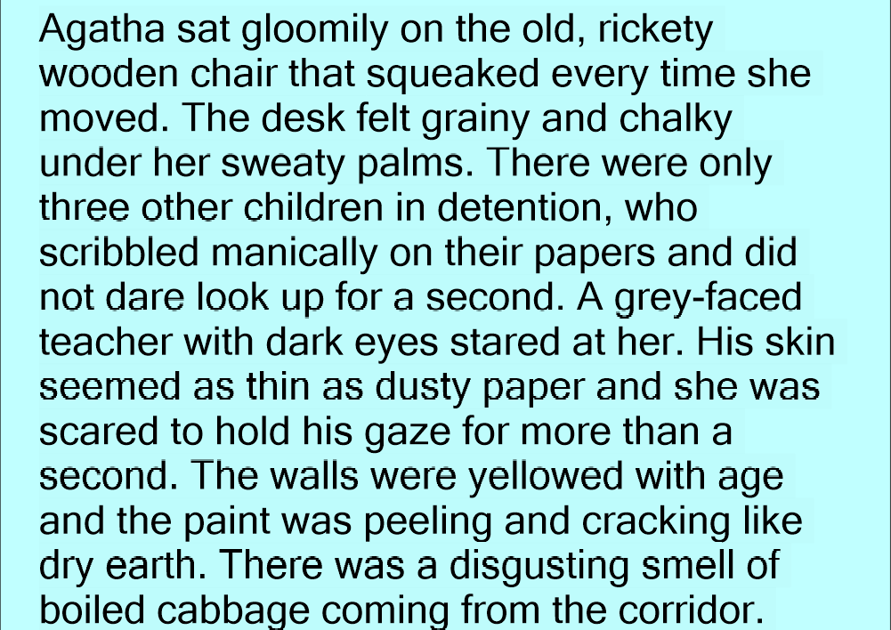

Slide 6
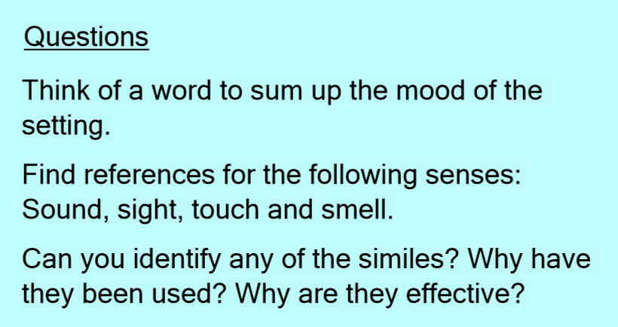

Slide 7
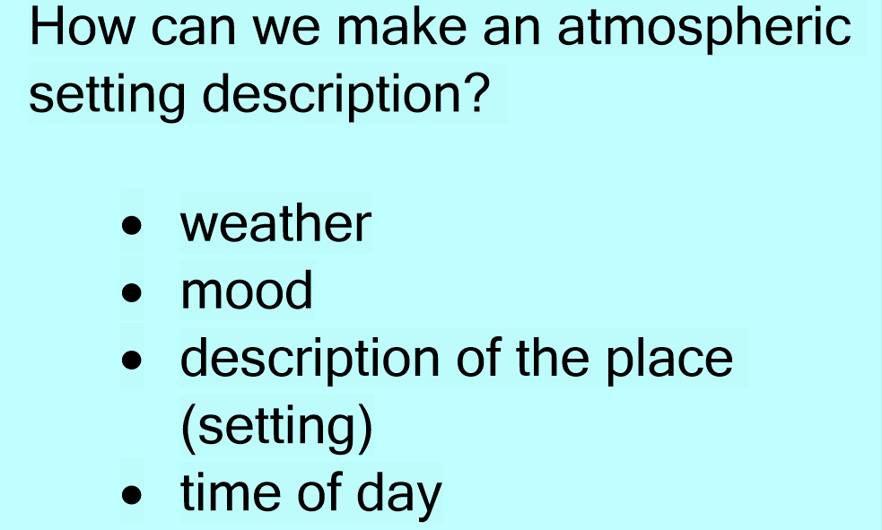

Slide 8
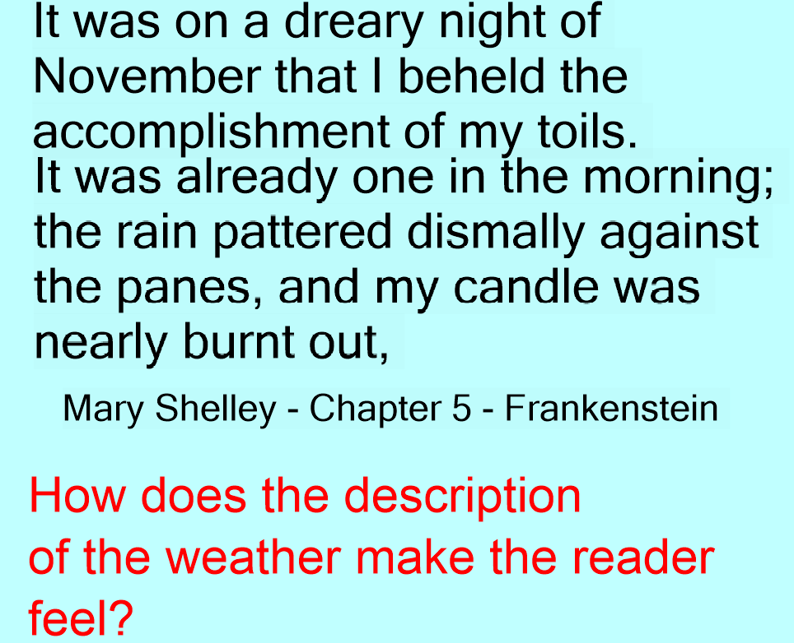

Slide 9
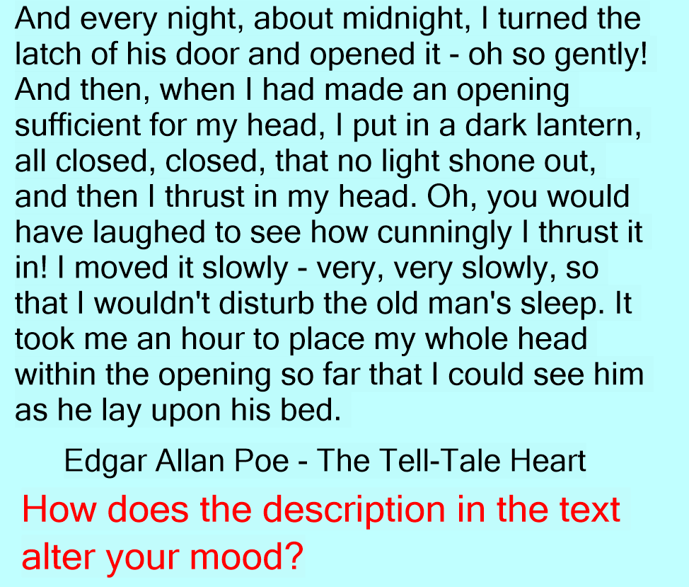

Slide 10
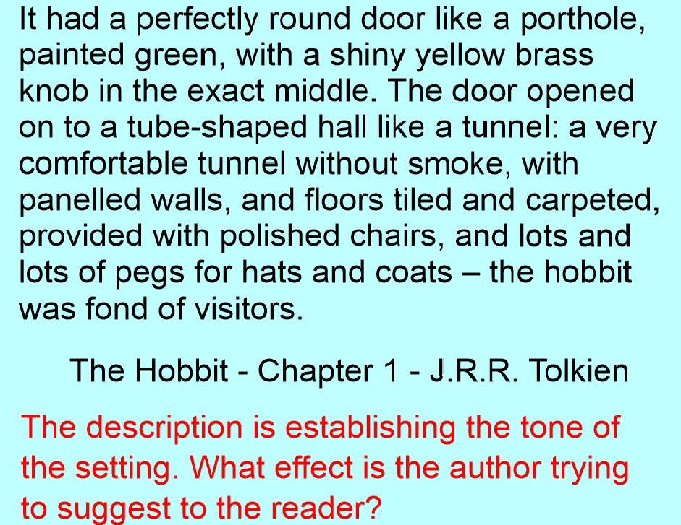

Slide 11
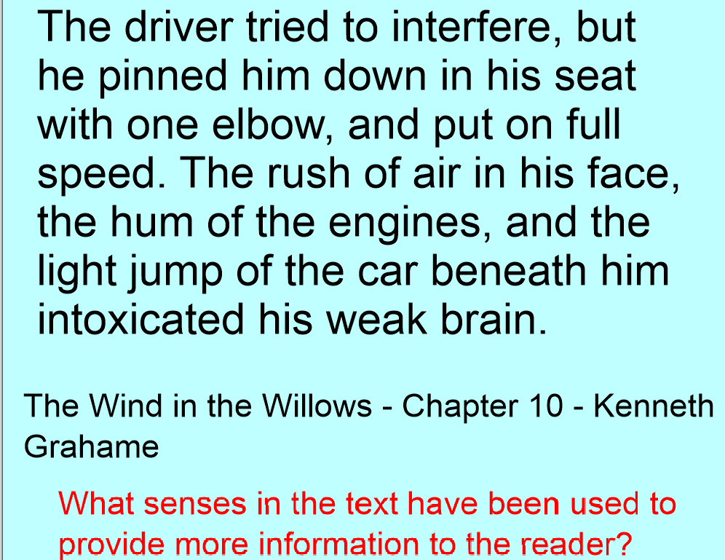

Slide 12
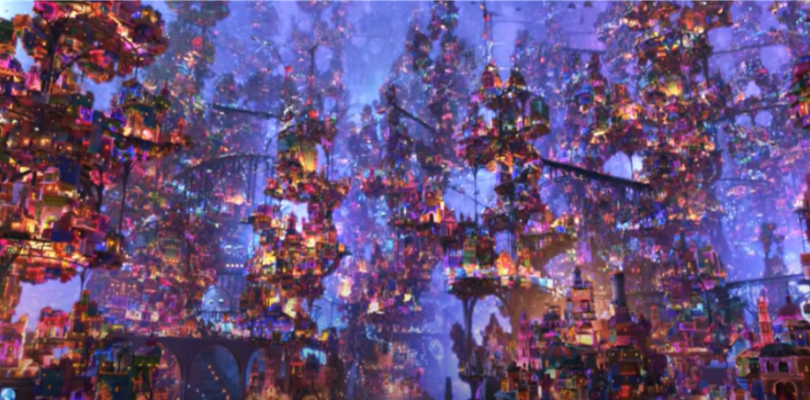
Watch the video clip from Coco which we will be basing our own atmospheric setting description about. Watch it first for enjoyment
Click here
If the link doesn’t work then try pressing control + clicking

Slide 13
Watch the video again and fill in the planning grid with powerful vocabulary which will help us create a brilliant atmosphere.
Click here
If the link doesn’t work then try pressing control + clicking

