Slide 1
Music – El Jarabe Taatio
19/11/20
To listen with attention to detail and recall sounds with increasing aural memory

Slide 2
https://www.youtube.com/watch?v=q-Rqdgna3Yw
Listen to the song first … try and listen to the different instruments

Slide 3
This piece of music is made up from an introduction and 6 motifs. We will only look a the first three today.
A motif is a section of music, and this piece has 6 sections (motifS) in it.
Intro – 0:00 -> 0:04
Motif 1 – 0:04 -> 0:18
Motif 2 – 0:18 -> 0:31 (then repeats Motif 1)
Motif 3 – 0:40-> 1:19 (stop there)

Slide 4
Instrument | Intro | Motif 1 | Motif 2 | Motif 3

Slide 5
Listen to the introduction and identify which instruments were being used.
You can draw something to represent the music – if the notes go higher pitched, your line/dash can go up, if the pitch goes down, so can your symbols.
Draw your swirls/lines to show the music changing through the motif. (If the instruments play the same tune, the symbols may look the same) LOOK at the example provided.

Slide 6
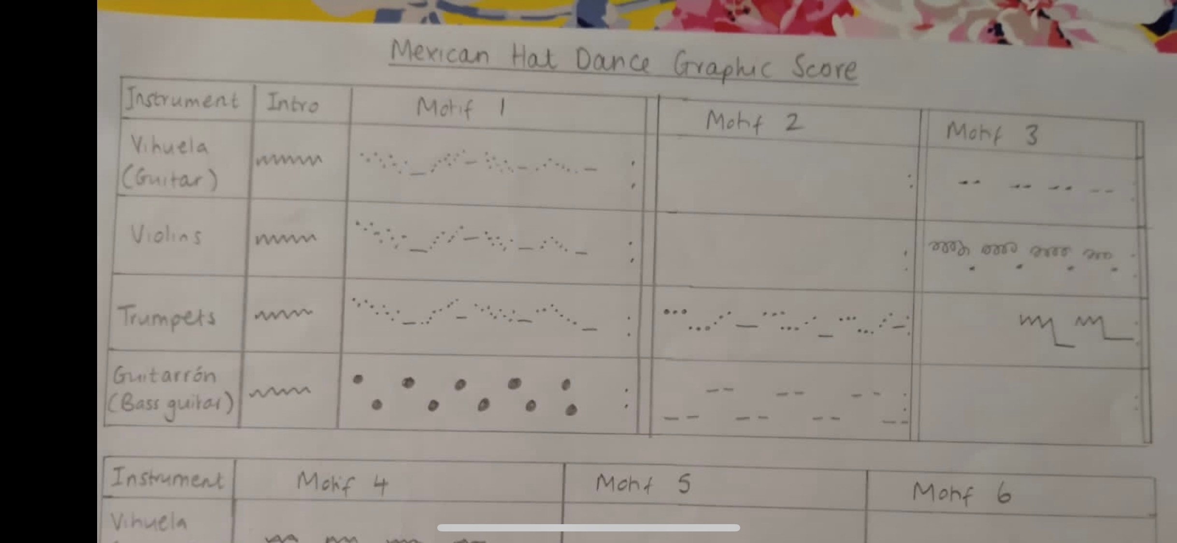
An example of what the instrumental sounds could look like

