Slide 2

The Big Questions
In your groups, write down your initial thoughts on your Big Questions Poster.
Will doing something risky or dangerous make others like or admire us?
What can we do when we are under pressure to do something
that makes us
feel uncomfortable?

Slide 3

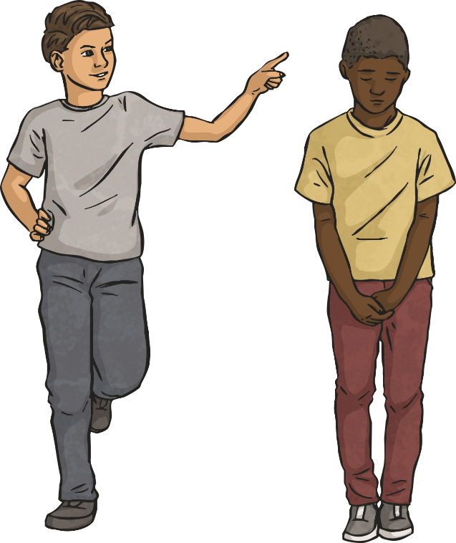
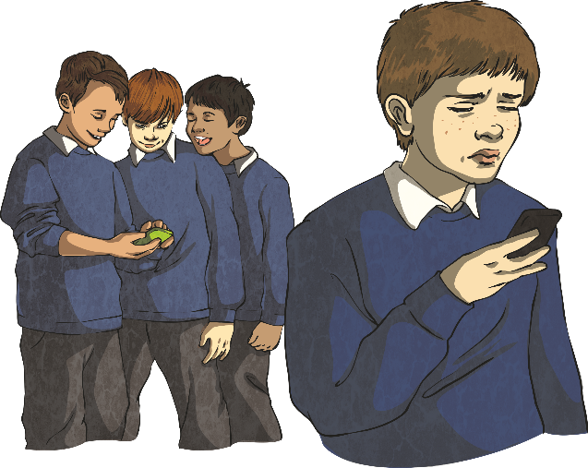
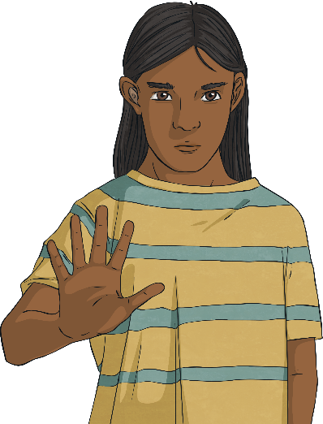
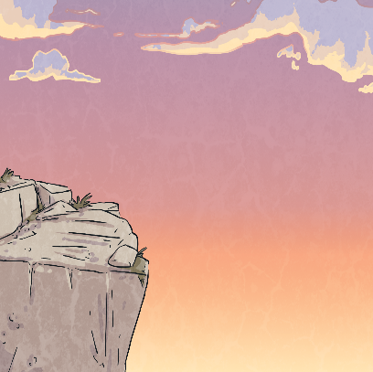
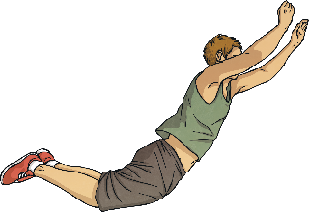
You Decide
If you don’t do what your friends say,
they won’t like you.
You need to try challenges you see on
social media to be cool.
It takes courage to speak up when you don’t want to do a dare.
Notes:
3

Slide 4
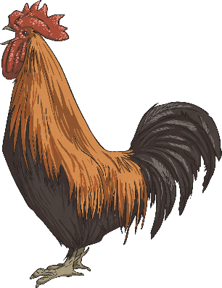
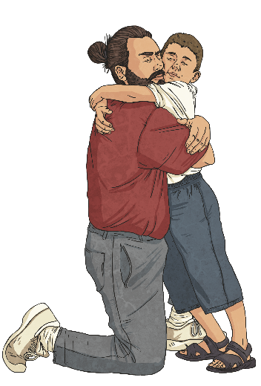
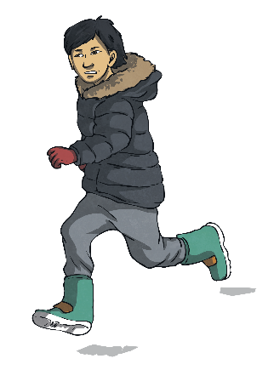
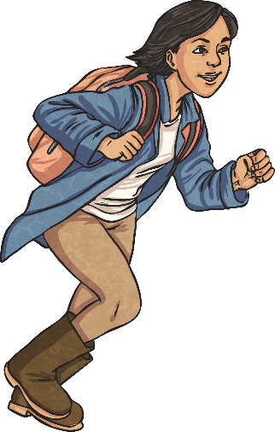
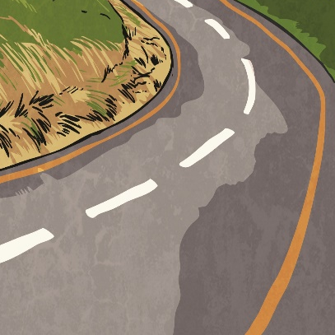
You Decide
If you don’t do a dare then you
are a chicken.
It’s OK to tell a trusted adult if someone has dared you
to do something that makes you feel uncomfortable
If everyone else is doing something,
then it must be safe.
Notes:
4

Slide 5

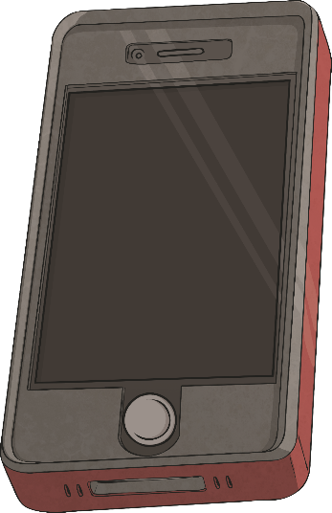

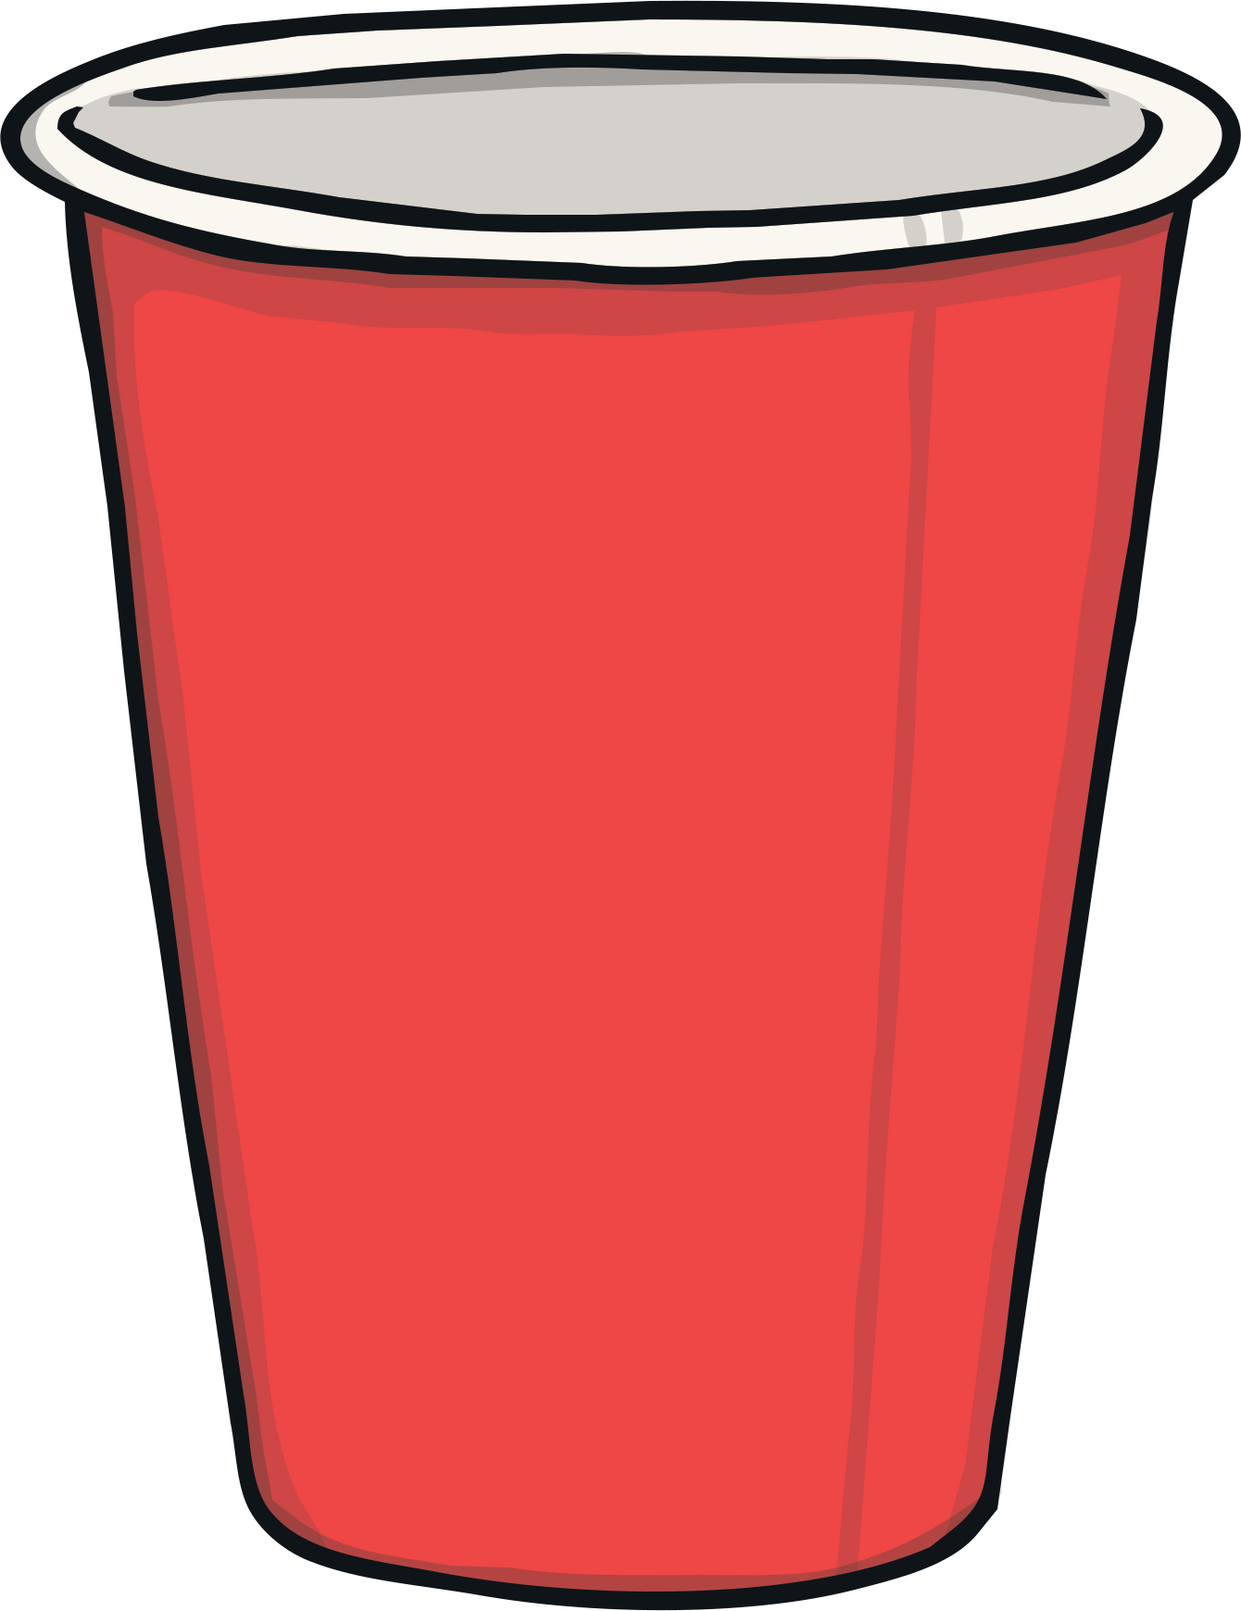
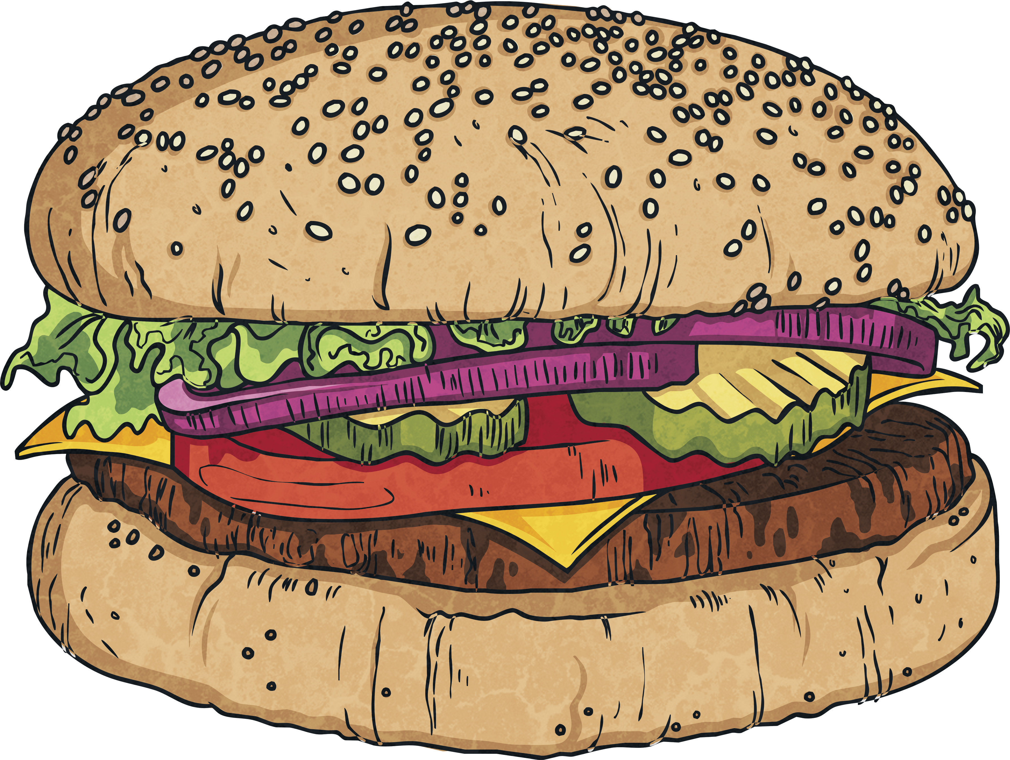
Under Pressure
Take a moment to think about a time when you felt under pressure to do something you weren’t happy about doing.
In different situations, the pressure to try something or do something comes from different sources.
Working with your partner, can you think of where pressure can come from?
friends
adverts
older children
other children
at school
social media

Slide 6
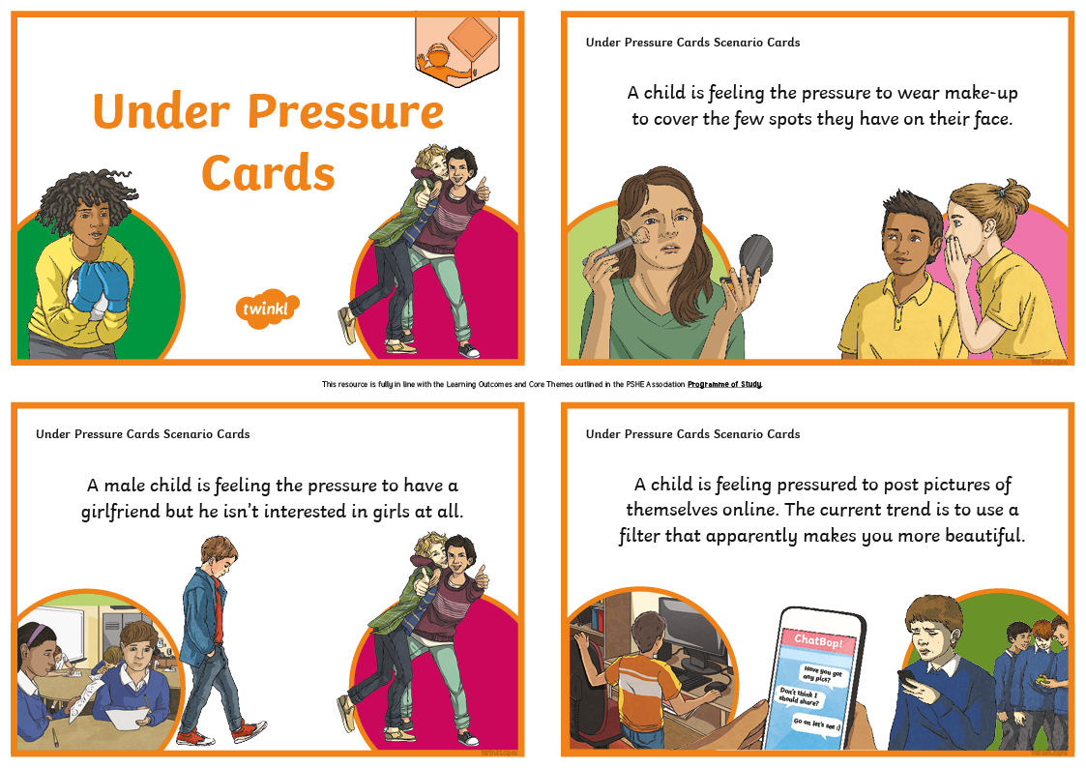
Under Pressure
Working with your partner, you are going to be looking at some different scenarios where someone is feeling under pressure to do something.
Read the scenario and discuss with your partner where the pressure is coming from, then sort the cards accordingly.

Slide 7
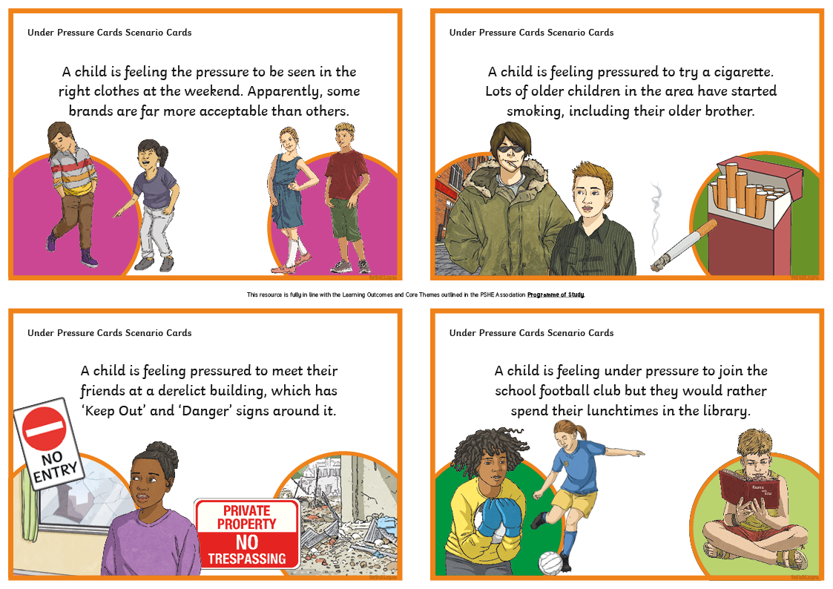
What Would You Do?
It’s time to look back at our Under Pressure Cards. Each pair needs to join another pair to form a small group. In your groups, you need to look back at the scenarios and discuss what you would do if you were in this situation.

Slide 8

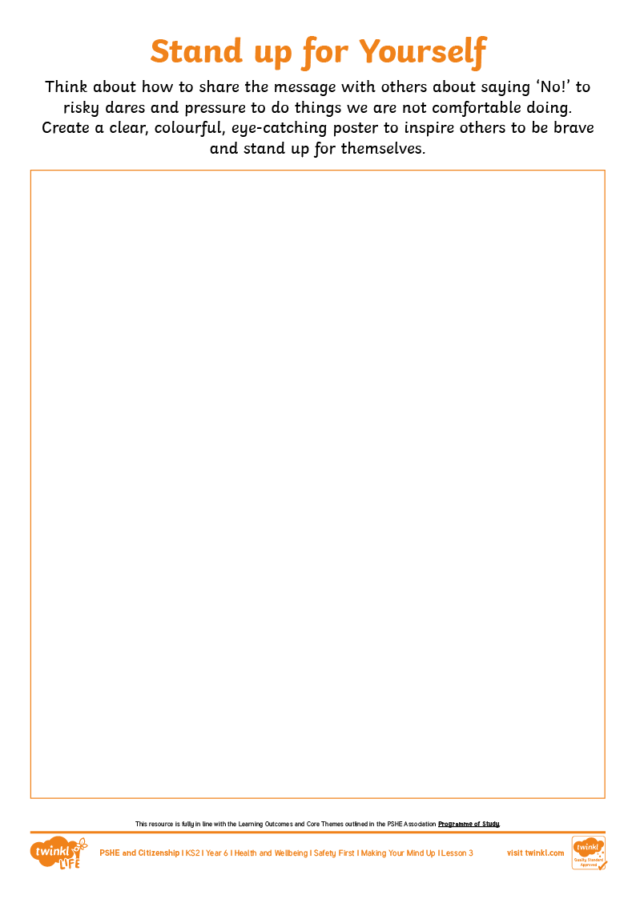
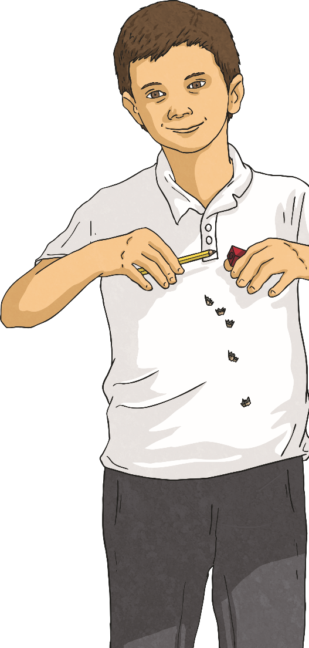
Stand up for Yourself!
It isn’t always easy to do the brave thing
and say ‘No!’ to something.
When others are putting pressure on us to
do something and we want to fit in or we
want them to like us, the easier choice is
to go along with things.
Today, we are going to make posters to
remind others to stand up for themselves
when they are dared or pressured into
doing something that makes them
uncomfortable or that is risky.

