Slide 1
L.O. To be able to use drama to recreate ‘The Arrival’.
Today we will be working in small groups retelling the story of ‘The Arrival’.
In your groups, you will need to act out the scene and free frame on the image that matches the picture.

Slide 2
Step into the picture
How do the characters feel?
Are they talking to each other?
What are they saying?
If you could ask them a question, what would it be?
What’s happening beyond the edges of the picture?
Justify your ideas!

Slide 3
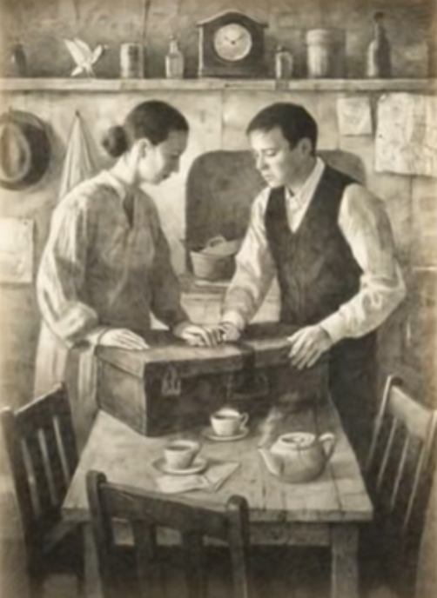

Slide 4
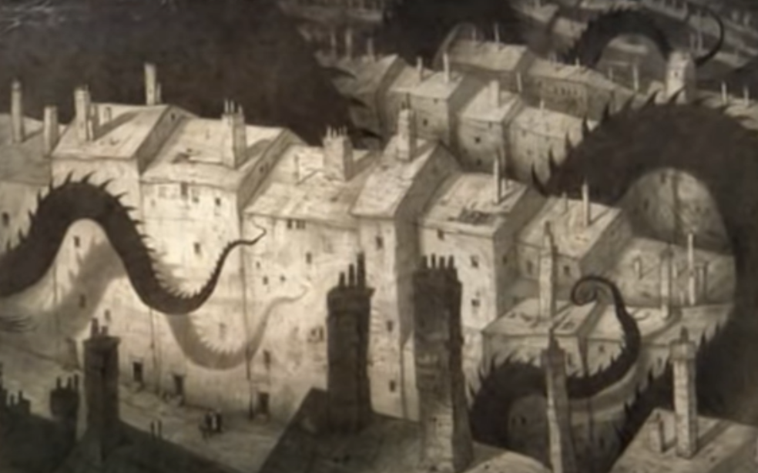

Slide 5
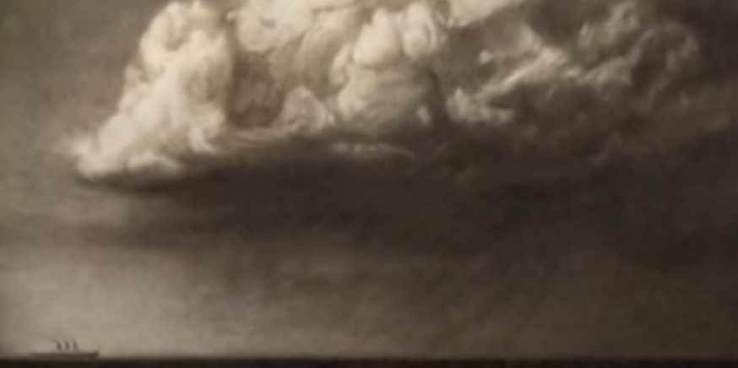

Slide 6
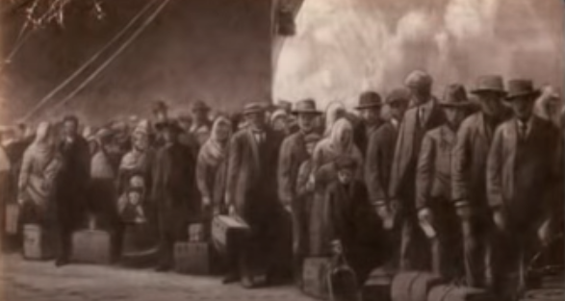

Slide 7
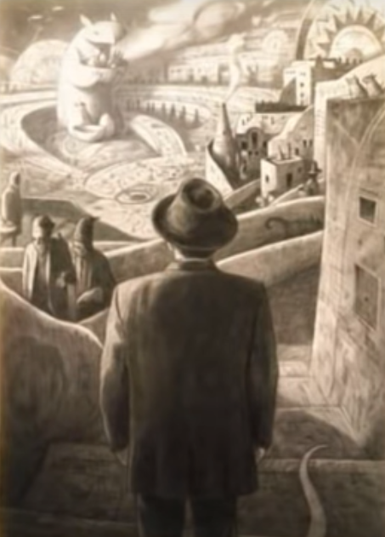

Slide 8
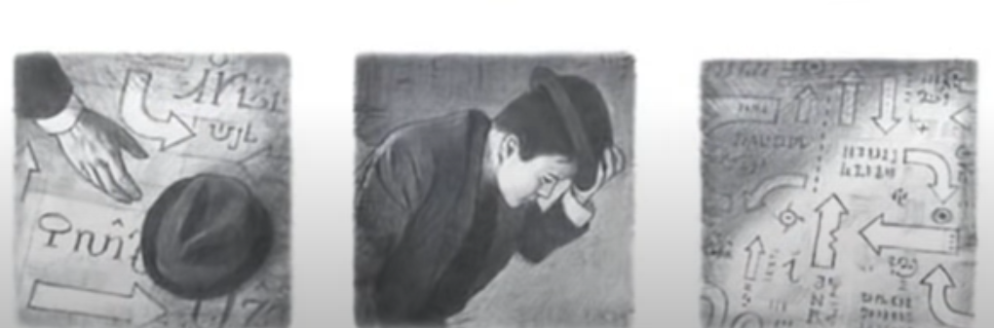

Slide 9
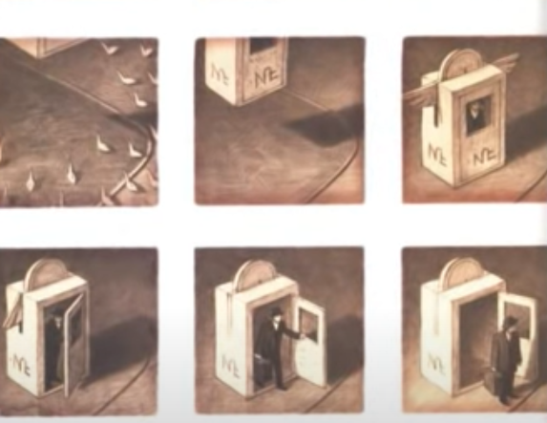

Slide 10
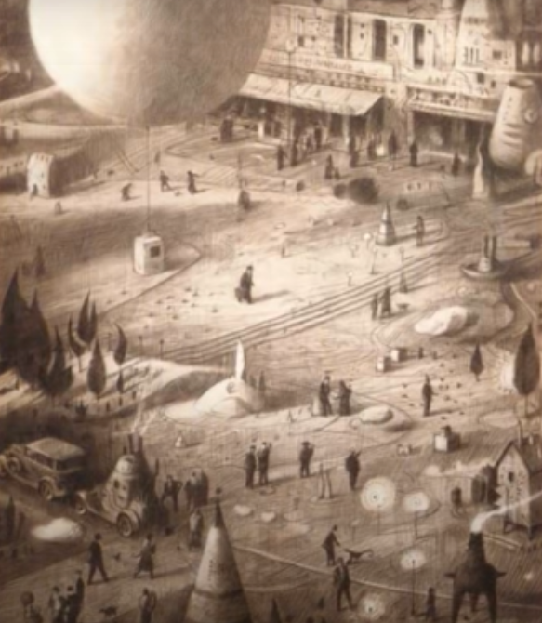

Slide 11
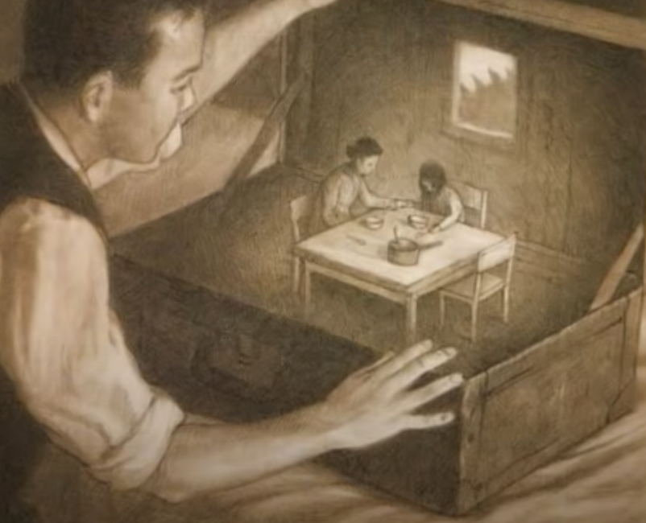

Slide 12


