Slide 2
Aim
I can assess and manage risks in different situations.
Success Criteria
I can assess a situation to see whether it might be dangerous.
I can understand that my own decisions and actions can help when I am in risky situations.
I can identify when and how to get help from others.
This resource is fully in line with the Learning Outcomes and Core Themes outlined in the PSHE Association’s Programme of Study.

Slide 3


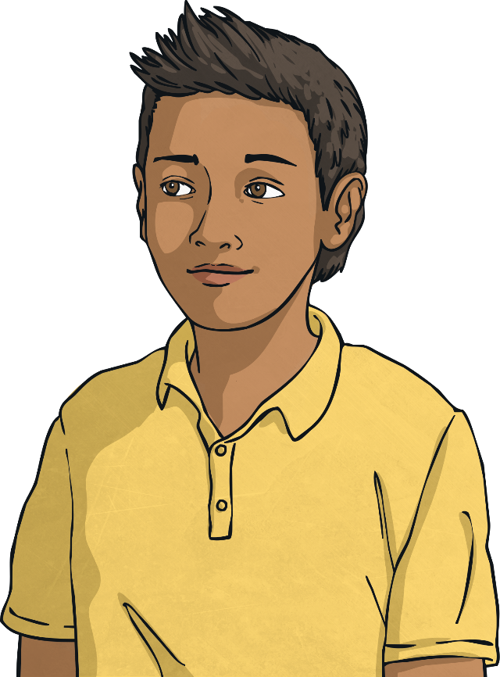
What can we do if we feel we are in a risky situation?
How can we decide if a situation is risky or dangerous?
Share your thoughts with a group.

Slide 4

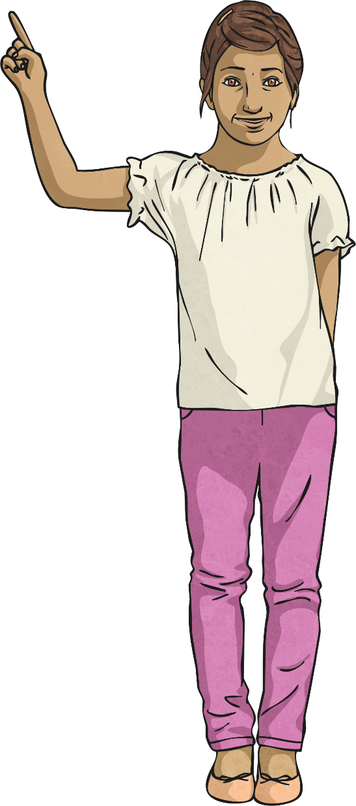
Risks, Dangers and Hazards
We hear all these terms when we think about staying
safe, but what do they mean?
Risk
This describes how great the chance is of
being harmed by a hazard.
Danger
This describes the situation where an
individual might be exposed to risk.
Hazard
This describes anything that can cause harm
(such as fire, electricity, a chemical and so on).

Slide 5


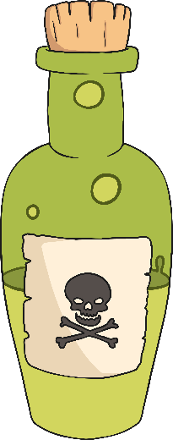



Risks, Dangers and Hazards
Some things carry a small risk; a low chance of anything
happening that could cause an individual harm.
Other things carry a high risk, meaning it is probable that something
will happen to cause harm.
Dangers and hazards also vary in severity. Some dangers and hazards
are far greater than others and can cause greater harm.

Slide 6


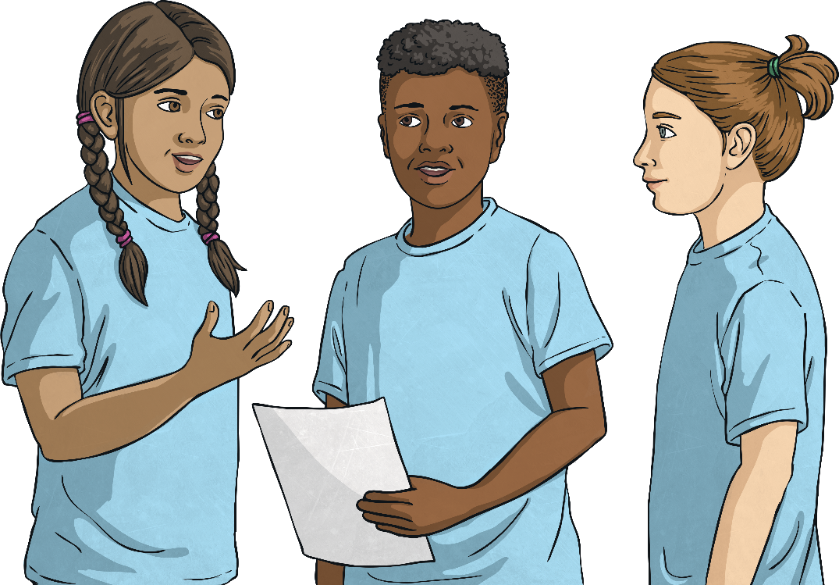

Risks, Dangers and Hazards
One of our Big Questions today asks what we can do if we feel we are in a risky situation.
But what is a risky situation? In your groups, see if you can think of a situation that a child your age might find themselves in where there might be an element of danger.
We’ll share and compare our ideas as a class
when you have thought of
some suggestions in
your groups.

Slide 7

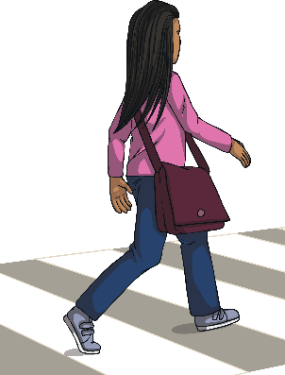
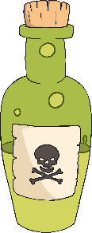
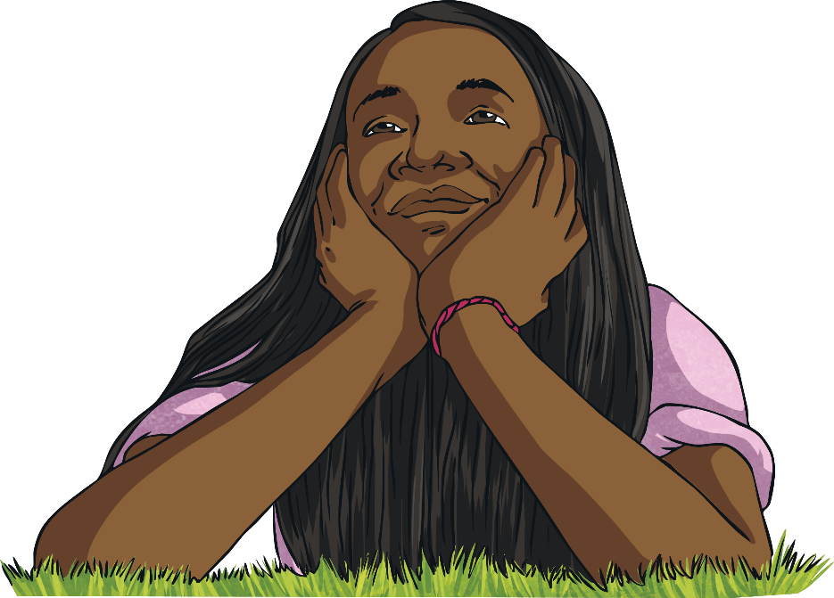
What Are the Dangers?
Every day we face risks and dangers. These range from
not very risky or dangerous at all, to very dangerous
situations (though these do not occur very often).
Our clever brains are always assessing situations for
danger, often without us realising it. From the risk of
doing something embarrassing to the risk of being
seriously hurt, our brains are checking all the time to
keep us safe.
We are subconsciously making decisions to stay safe
all the time, based on everything we have learnt as
we have been growing up. This might include
crossing the road, avoiding hot objects or staying
with our grown-up when we are out and about.

Slide 8

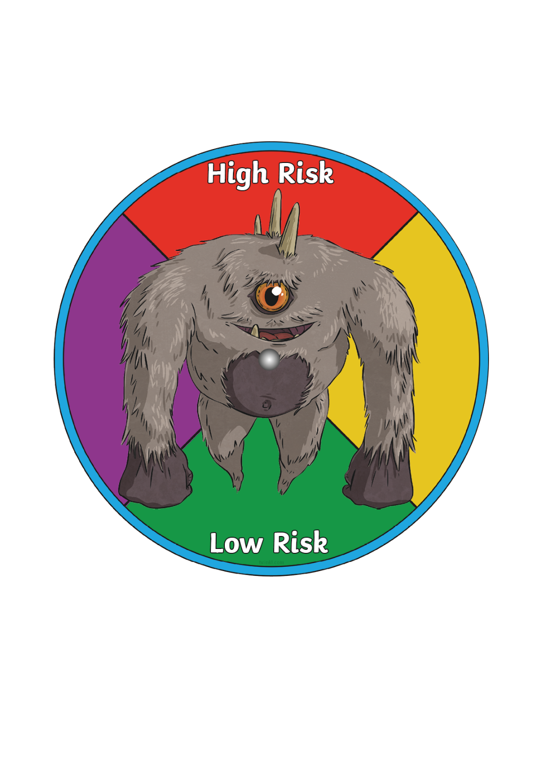

What Are the Dangers?
Although we have learnt a lot since we were born about how to stay safe, we still sometimes find ourselves in new, unfamiliar and risky situations.
When this happens, we have to consciously
assess the risks and potential danger.
In your pairs, you are going to be
assessing the risk of the given
situations. Discuss the situation and
agree on the level of risk, using your
risk-o-meter.

Slide 9

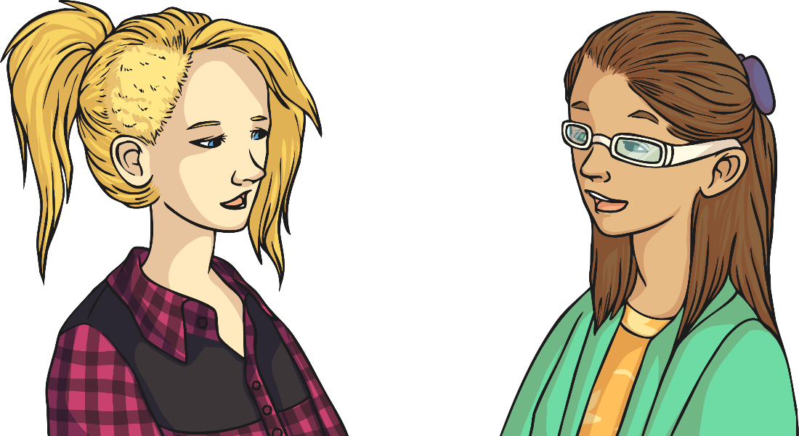

What Are the Dangers?
You are at your friend’s house playing video games. Their parents pop out to the shop and your friend suggests you play a game of dare, drinking different liquids from the bathroom cupboard.
What dangers might be involved?
How risky is this situation?

Slide 10
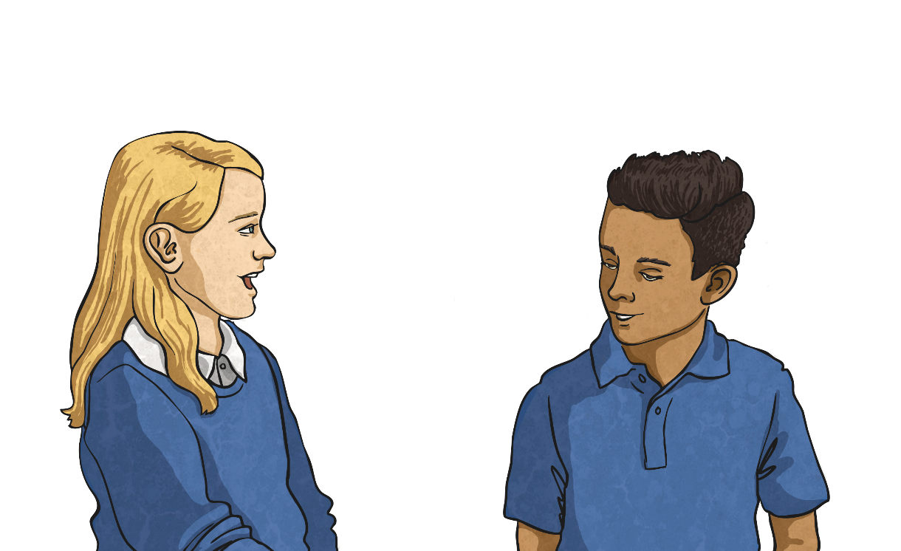
What Are the Dangers?
You are at the local park with your friends. It is quite busy and some children’s parents are on a bench nearby. There is a large tree there that all the children enjoy climbing. You decide to join in and do some climbing, too.
What are the potential dangers?
How risky is this situation?

Slide 11
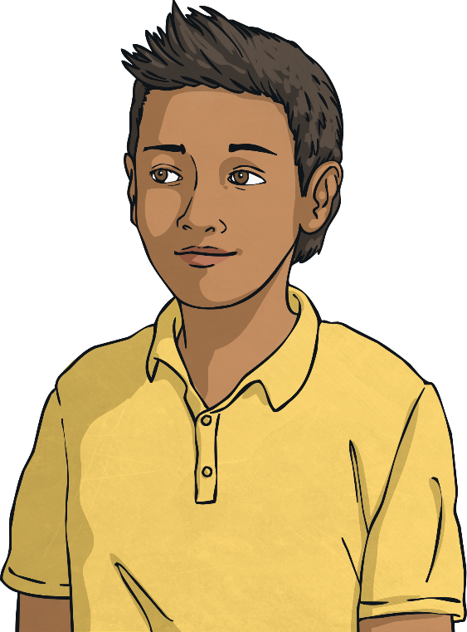
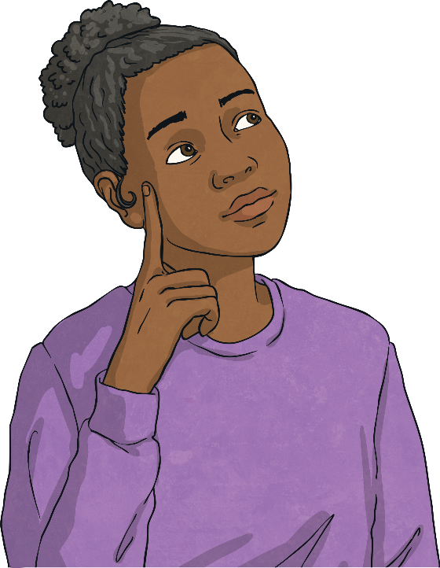
What Are the Dangers?
You go with some friends to a stable where they help out with the horses. Your friends suggest taking the horses out in the woods nearby for a ride, without telling the owner of the stables. You have never ridden before.
What dangers could occur in this situation?
How risky is this situation?

Slide 12


What Are the Dangers?
You have been playing an online game for months and usually chat online to the same group of people when you play as a team. One of the other children in the team, who is the same age as you, suggests meeting up.
You get on really well with them and seem to
have the same sense of humour, as well as
liking a lot of the same things.
What are the possible dangers here?
How risky is this situation?

Slide 13
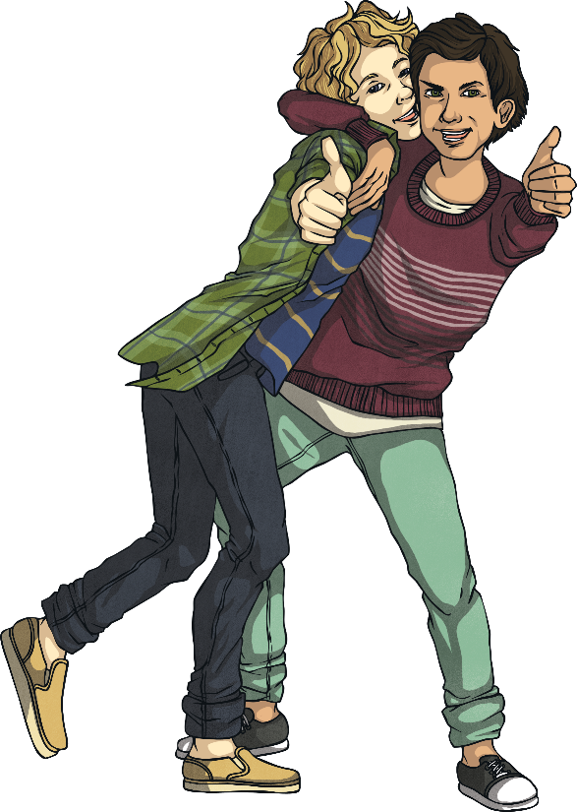
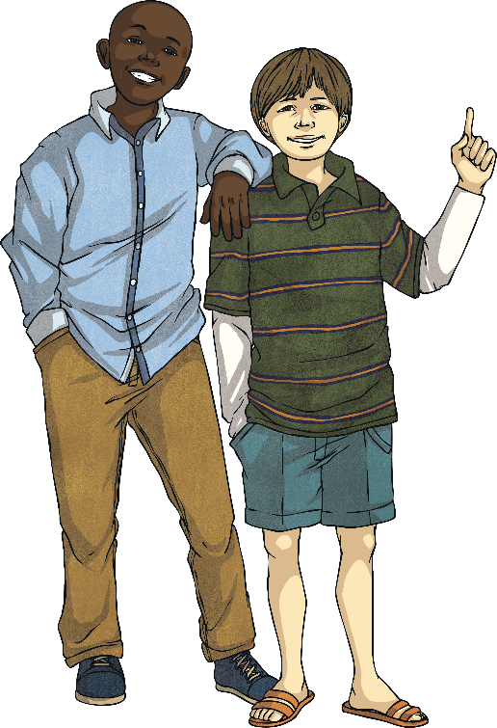
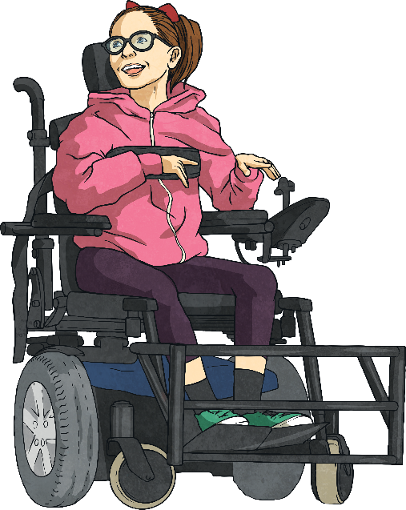
What Are the Dangers?
Well done for having a go at assessing the level of risk in those scenarios.
It isn’t always easy in a new, unfamiliar situation to know whether there
is any risk of danger or not.
We want to have fun, join in with our friends and try new things, but there are safe ways to do this, where the risks of danger are heavily reduced.
Some situations we find ourselves in are not
fun in any way, but we might feel
pressure to join in or give something
a go, even when we know it is
risky and could be dangerous.

Slide 14



Stop, Think, Act
We need to make sensible,
smart decisions that will keep
us and others safe from harm
and take the appropriate action needed for this to happen.
We need to have the courage to speak up
and say that we don’t want to do something,
or to ask for help.
When faced with unfamiliar risky situations, we have to
be smart and brave.
We need to give
ourselves time to consider
the potential dangers.

Slide 15





Stop, Think, Act
When our amazing brain sends us one of those warning signals, telling us that the situation doesn’t feel right or might carry a risk of danger,
we need to:
stop;
listen to our brain’s signal;
think about what to do;
make an informed decision about how to act.

Slide 16
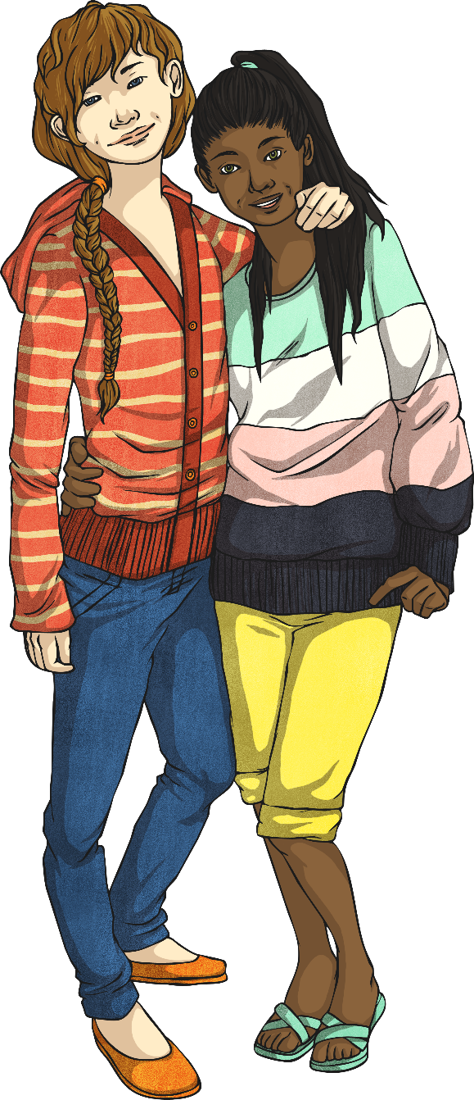
Who Could Help?
One incredibly important thing to do when we find
ourselves in a risky or dangerous situation is to get help.
When we stop, think and act, the action might be to get
the help needed to avoid risk or danger.
We need to know who could help in different situations
and have people we know we can trust to speak to if we
are ever unsure about something.
Having a support network around us means having people
we can get help from when we need to.

Slide 17
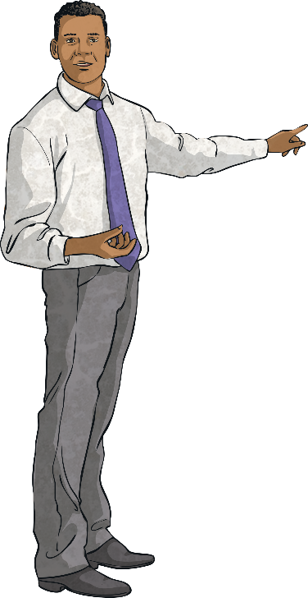
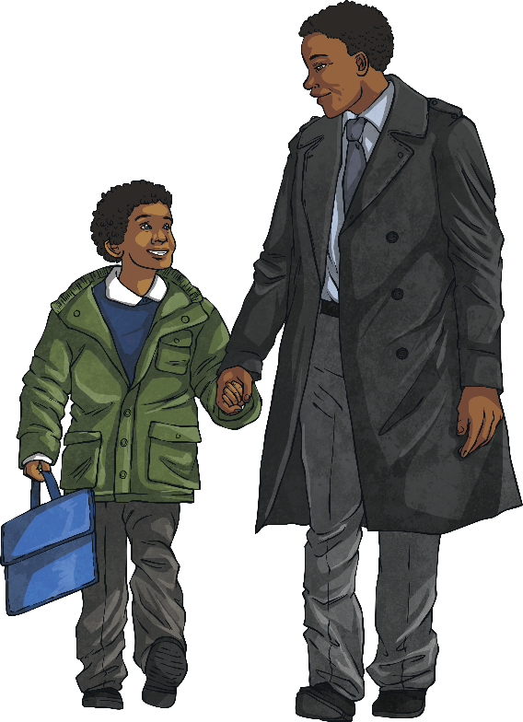
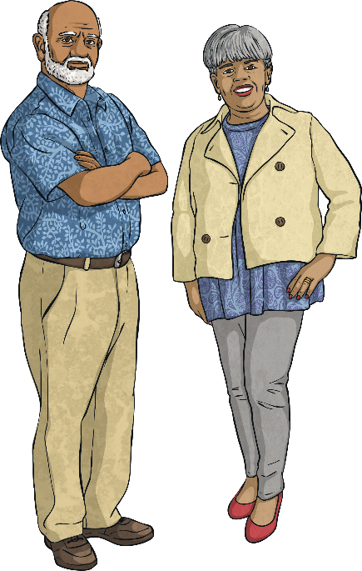
Who Could Help?
We could ask…
a teacher
grandparents
our friends’ parents

Slide 18
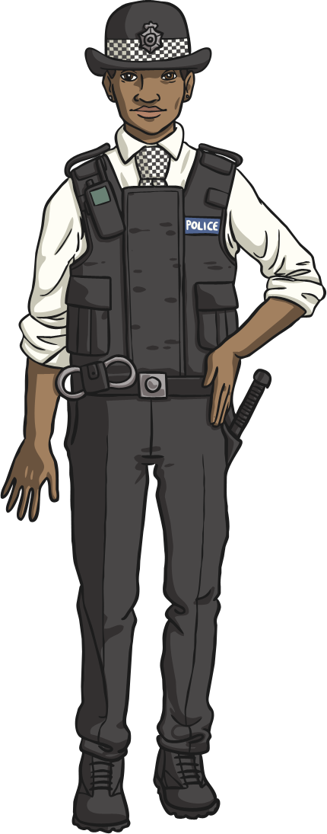
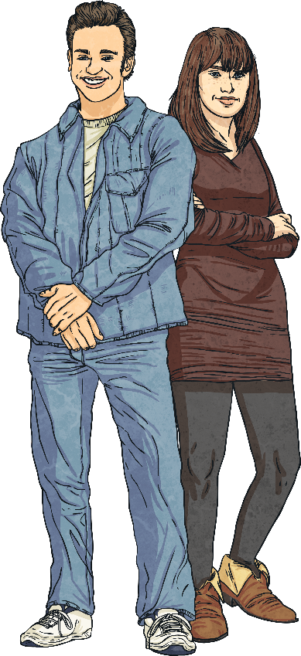

Who Could Help?
We could ask…
our friends
the police
neighbours

Slide 19

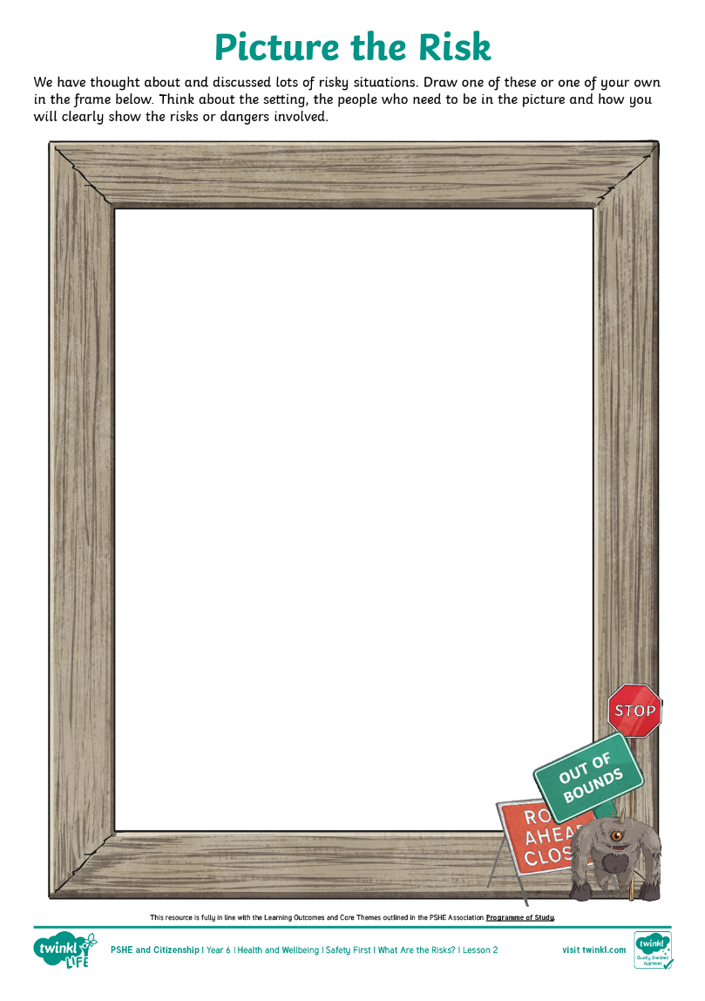
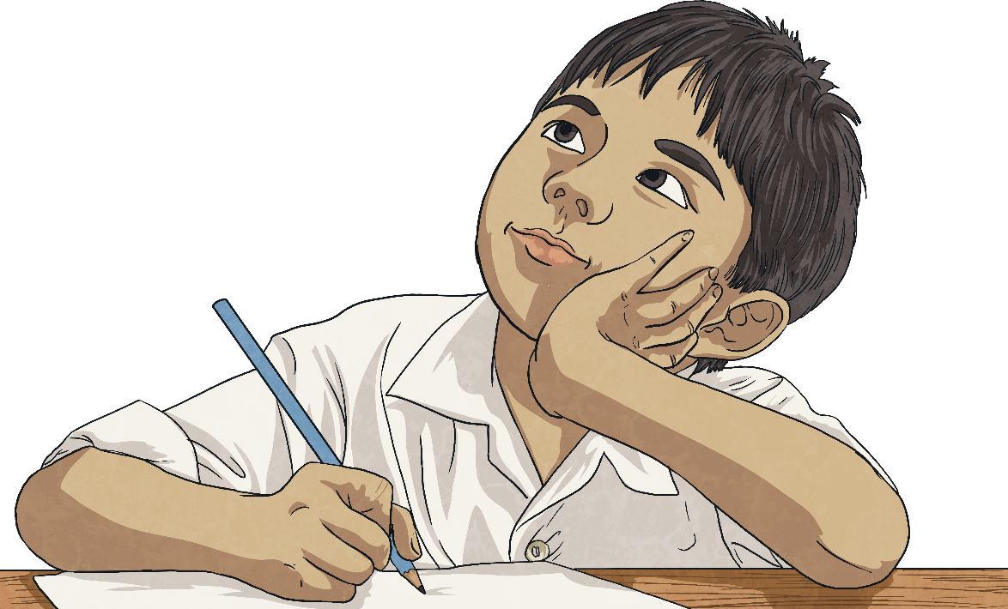
Picture the Risk
Think about all the risks and dangers we have
talked about today.
Draw a picture that shows a risky situation.
You can choose which situation you are
going to draw. Think about the setting,
the people who are there and any dangerous
items that need to be in the picture.

Slide 20


How can we decide if a situation is risky or dangerous?
What can we do if we feel we are in a risky situation?
What important learning will you take away from today’s lesson?

Slide 21
Aim
I can assess and manage risks in different situations.
Success Criteria
I can assess a situation to see whether it might be dangerous.
I can understand that my own decisions and actions can help when I am in risky situations.
I can identify when and how to get help from others.

