Slide 1
My pilgrimage

Slide 2
What do you know about pilgrimages?
What is the purpose of a pilgrimage?
Who takes part in a pilgrimage?
Why is a pilgrimage important to some religions?

Slide 3
Have you ever been on a pilgrimage?
Where did you go?
What did you do?
How did you feel?
Did your pilgrimage change the way you feel about yourself and your religion?

Slide 4
Where would you go on a pilgrimage?
We know to go on a pilgrimage mean to go to a place of spiritual significance.
If you were to go on a Pilgrimage where would you go?
What would you do?

Slide 5
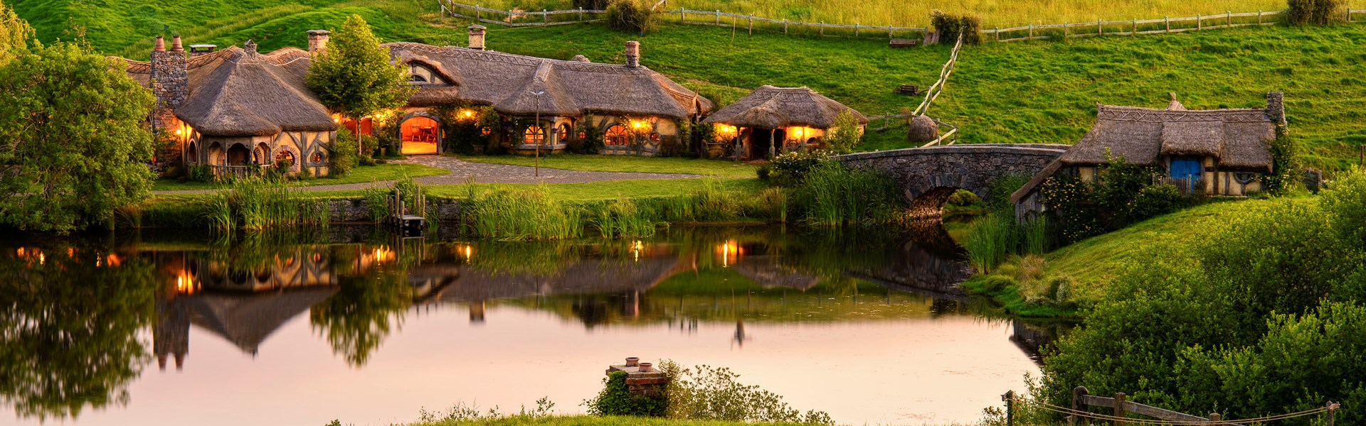
Mrs Oliver’s pilgrimage
The Shire (Hobbiton)
This is a very important place to me for many reasons.
It is one of the sets that was used for one of my favourite films.
It is one of the most beautiful and calming places in the world.
I have some of my happiest memories in this place.
For all of these reasons, I would pilgrimage here. It is not a place that I am able to visit very often so it means more when I am able to be there.

Slide 6
Where would you pilgrimage to?
Think of a place that is important to you.
Why have you chosen this place?
What memories do you have here?
How does this place make you feel?

