Slide 1


Early Writing

Slide 2
Early Stages of Writing
This is an example of early attempts at writing, that would often be described as scribbling. A child may hold the writing tool in a fist grip because their hands are still developing.
At this stage the child is starting to mimic writing they have seen. It is really beneficial to see adults around them writing, shopping lists or notes etc. and encourages children to experiment. They may tell you what they have ‘written’ and the control of the tools they are using is increasing.

Slide 3
Children may now start to write familiar letters they have seen, such as letters from their name. Being able to recognise their written name is helpful when starting school. Write their name on drawings they do, label bags to that they become familiar with the letters. Their names should be written beginning with a capital letter, then the rest with lower case letters. You can start to introduce the letter formation rhymes which are in the videos on the school ‘video resource centre’.
Children are now starting to write strings of letters and may be able to link the sound with the letter. Children will often say ‘it’s m for Mum’. They will be able to hear the first sound in a word, followed by the last sound.

Slide 4
During the Reception year as children acquire the phonics sounds they will start to break up a word into their individual sounds and be able to write the corresponding letters. Letters are now easily recognisable and they will begin to write short captions.
Children are now able to remember more sounds and will be using soundmats to support themselves. They will learn a number of ‘tricky words’ which are words that don’t follow the usual rules when sounding them out. The children will bow be able to write sentences using the sounds they have learnt so far. They will use finger spaces, capital letters and have more control in writing on the line.

Slide 5

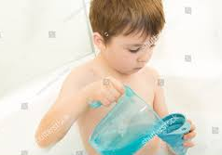
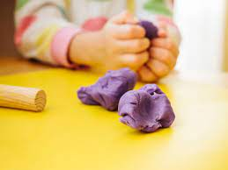
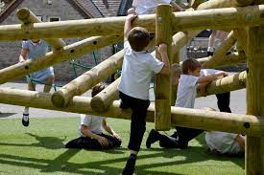
Strengthening hands
Some children may not be interested in making marks yet and for some children their hands may not have developed, and may find it uncomfortable. Don’t worry there are lots of ways to strengthen their hands.
Squeezing, squashing, moulding, rolling, all strengthens little hands and who doesn’t love playdough. Find a recipe below to make your own, it’s really simple.
You may not think a trip to the park is helping your child write, but as they grip and climb they are strengthening their muscles in their shoulders, arms and hands which they need to be able to write.
Bath-time – just add jugs and containers to fill and empty.

Slide 6
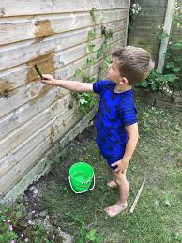
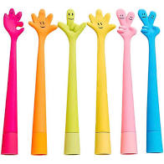

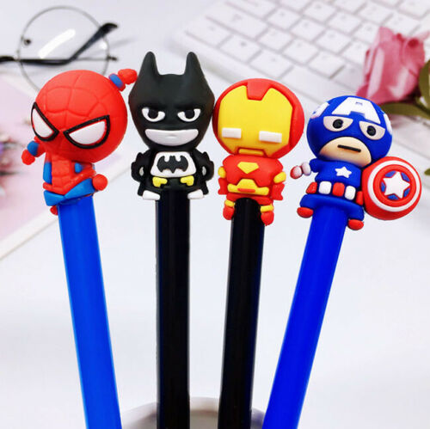
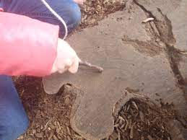
Encouraging writing and mark-making
Look out for pens and pencils and notebooks of their favourite characters to encourage mark making.
If your child loves to play outside find a stick and make marks or use big brushes and water.

