Slide 1
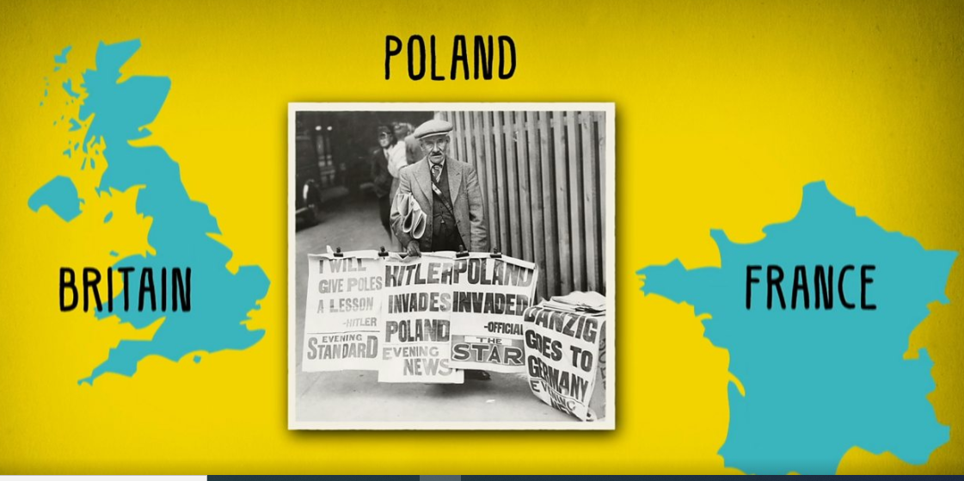
Britain declares War on Germany!
https://www.bbc.co.uk/teach/class-clips-video/history-ks2-the-outbreak-of-world-war-2/z7d847h

Slide 2
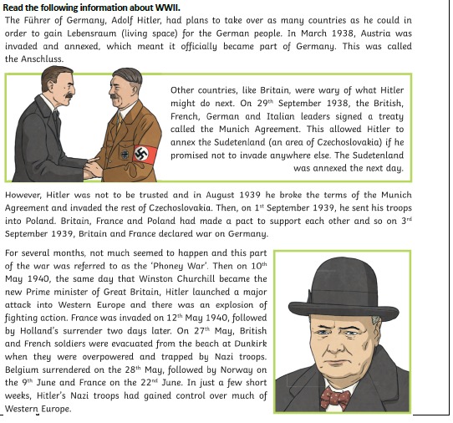

Slide 3
These were the words Neville Chamberlain, who was UK Prime Minister at the time, spoke when announcing the war:
“I am speaking to you from the cabinet room at 10 Downing Street. This morning the British ambassador in Berlin handed the German government a final note stating that unless we heard from them by 11 o'clock that they were prepared at once to withdraw their troops from Poland, a state of war would exist between us. I have to tell you now that no such undertaking has been received, and that consequently this country is at war with Germany.”
https://www.bbc.co.uk/teach/class-clips-video/history-ks2-the-outbreak-of-world-war-2/z7d847h

Slide 4
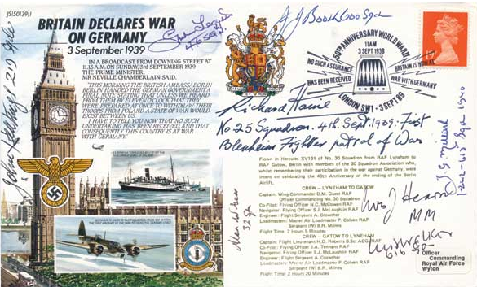
Write an announcement informing the country that Britain is at war.

